Slide 1

Human Impact Route Assessment
Identifying Risks to Vulnerable Road Users along Construction Vehicle Truck Routes
Notes:
Good afternoon, my name is Lora Colussi and I am a transport planner from Aurecon.

Slide 2






Route Choice Working GROUP
Route Choice Working Group (core)
Jennifer Thompson, VicRoads
Victor Trumper, VicRoads
Lora Colussi, Aurecon
With thanks to the following contributors:
Dane Miokovic, Melbourne Metro Rail Authority & VicRoads
Andrew Cron, City of Melbourne
Fu-Ho Chung, VicRoads
Ben Phillips, VicRoads
Simon Mcleish, Fulton Hogan
Ken Beer, Safe Systems Solutions
Johann Tay, Safe System Solutions
Matthew Bennett, RMIT (as independent reviewer)
Notes:
I am here representing a working group tasked with prioritising Vulnerable Road User safety by improving truck route selection processes.
I am going to discuss the findings of the working group and explain the process developed and piloted. Matthew Bennett, will then go on to discuss his independent evaluation of the our process and tool.

Slide 3
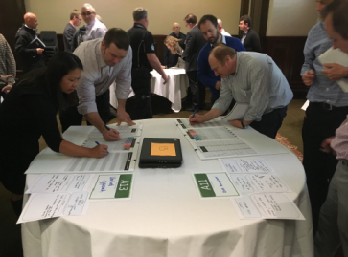
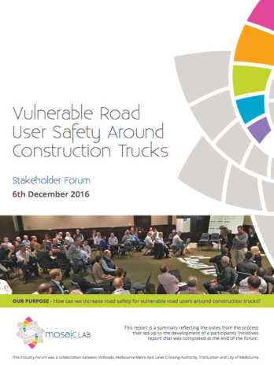
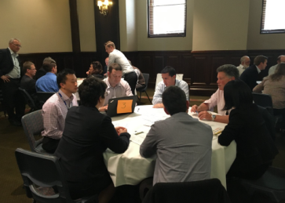
Industry Forum - December 6, 2016
Cross-section of industry, projects, regulators, councils, etc
Common view of importance of the issue
Opportunity to build improvements on the foundation of the Melbourne major projects
Notes:
In 2016 MMRA and VicRoads held a VRU Safety Around Construction Trucks Forum. At the forum the 100+ delegates from Victorian government agencies, regulators and industry identified that current truck route planning practices do not consider the impact of trucks upon pedestrians and cyclists who share the road network.
However, us Melbournians are not alone. In response to a high number of cyclists fatalities involving heavy vehicles in London. TFL commissioned a review of the construction sector’s transport activities.

Slide 4
Findings of Transport for London review
Road risk is less important
Lack of ownership of road risk by principal contractors
Route planning to avoid cyclists is especially difficult in construction projects due to the transitory nature of sites
Source: TRL PPR639
Notes:
Significant findings of this review include:
“Road risks is viewed as less important than general health and safety risk”
“There is a lack of ownership of road risk by clients and principal contractors in the construction industry”;
“Evidence suggest that there is a lack of awareness about road risk in the construction industry”;
“Route planning to avoid interactions with cyclists is especially difficult on construction projects due to the transitory nature of sites”
Based on the review , TFL developed the Construction Logistics & Community Safety CLOCS program. Which I will come back too in a moment.

Slide 5
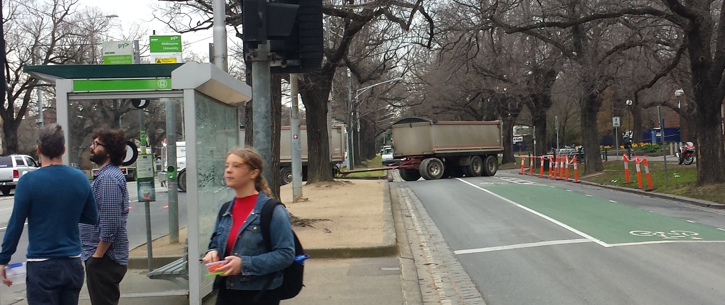
Current Practice
Notes:
Lets return to the situation in Australia.
In VIC and the other states and territories a 19m articulated truck or truck and trailer can travel along any road, arterial or local unless that road is subject to a load limit. As a result the industry will select the quickest route to and from a site, limited only by physical or geometric constraints along the road, information easily found on the heavy vehicle network maps published by each states road authority.

Slide 6
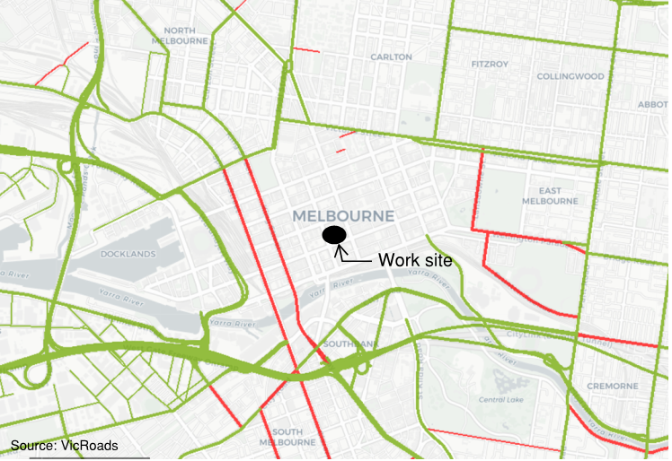
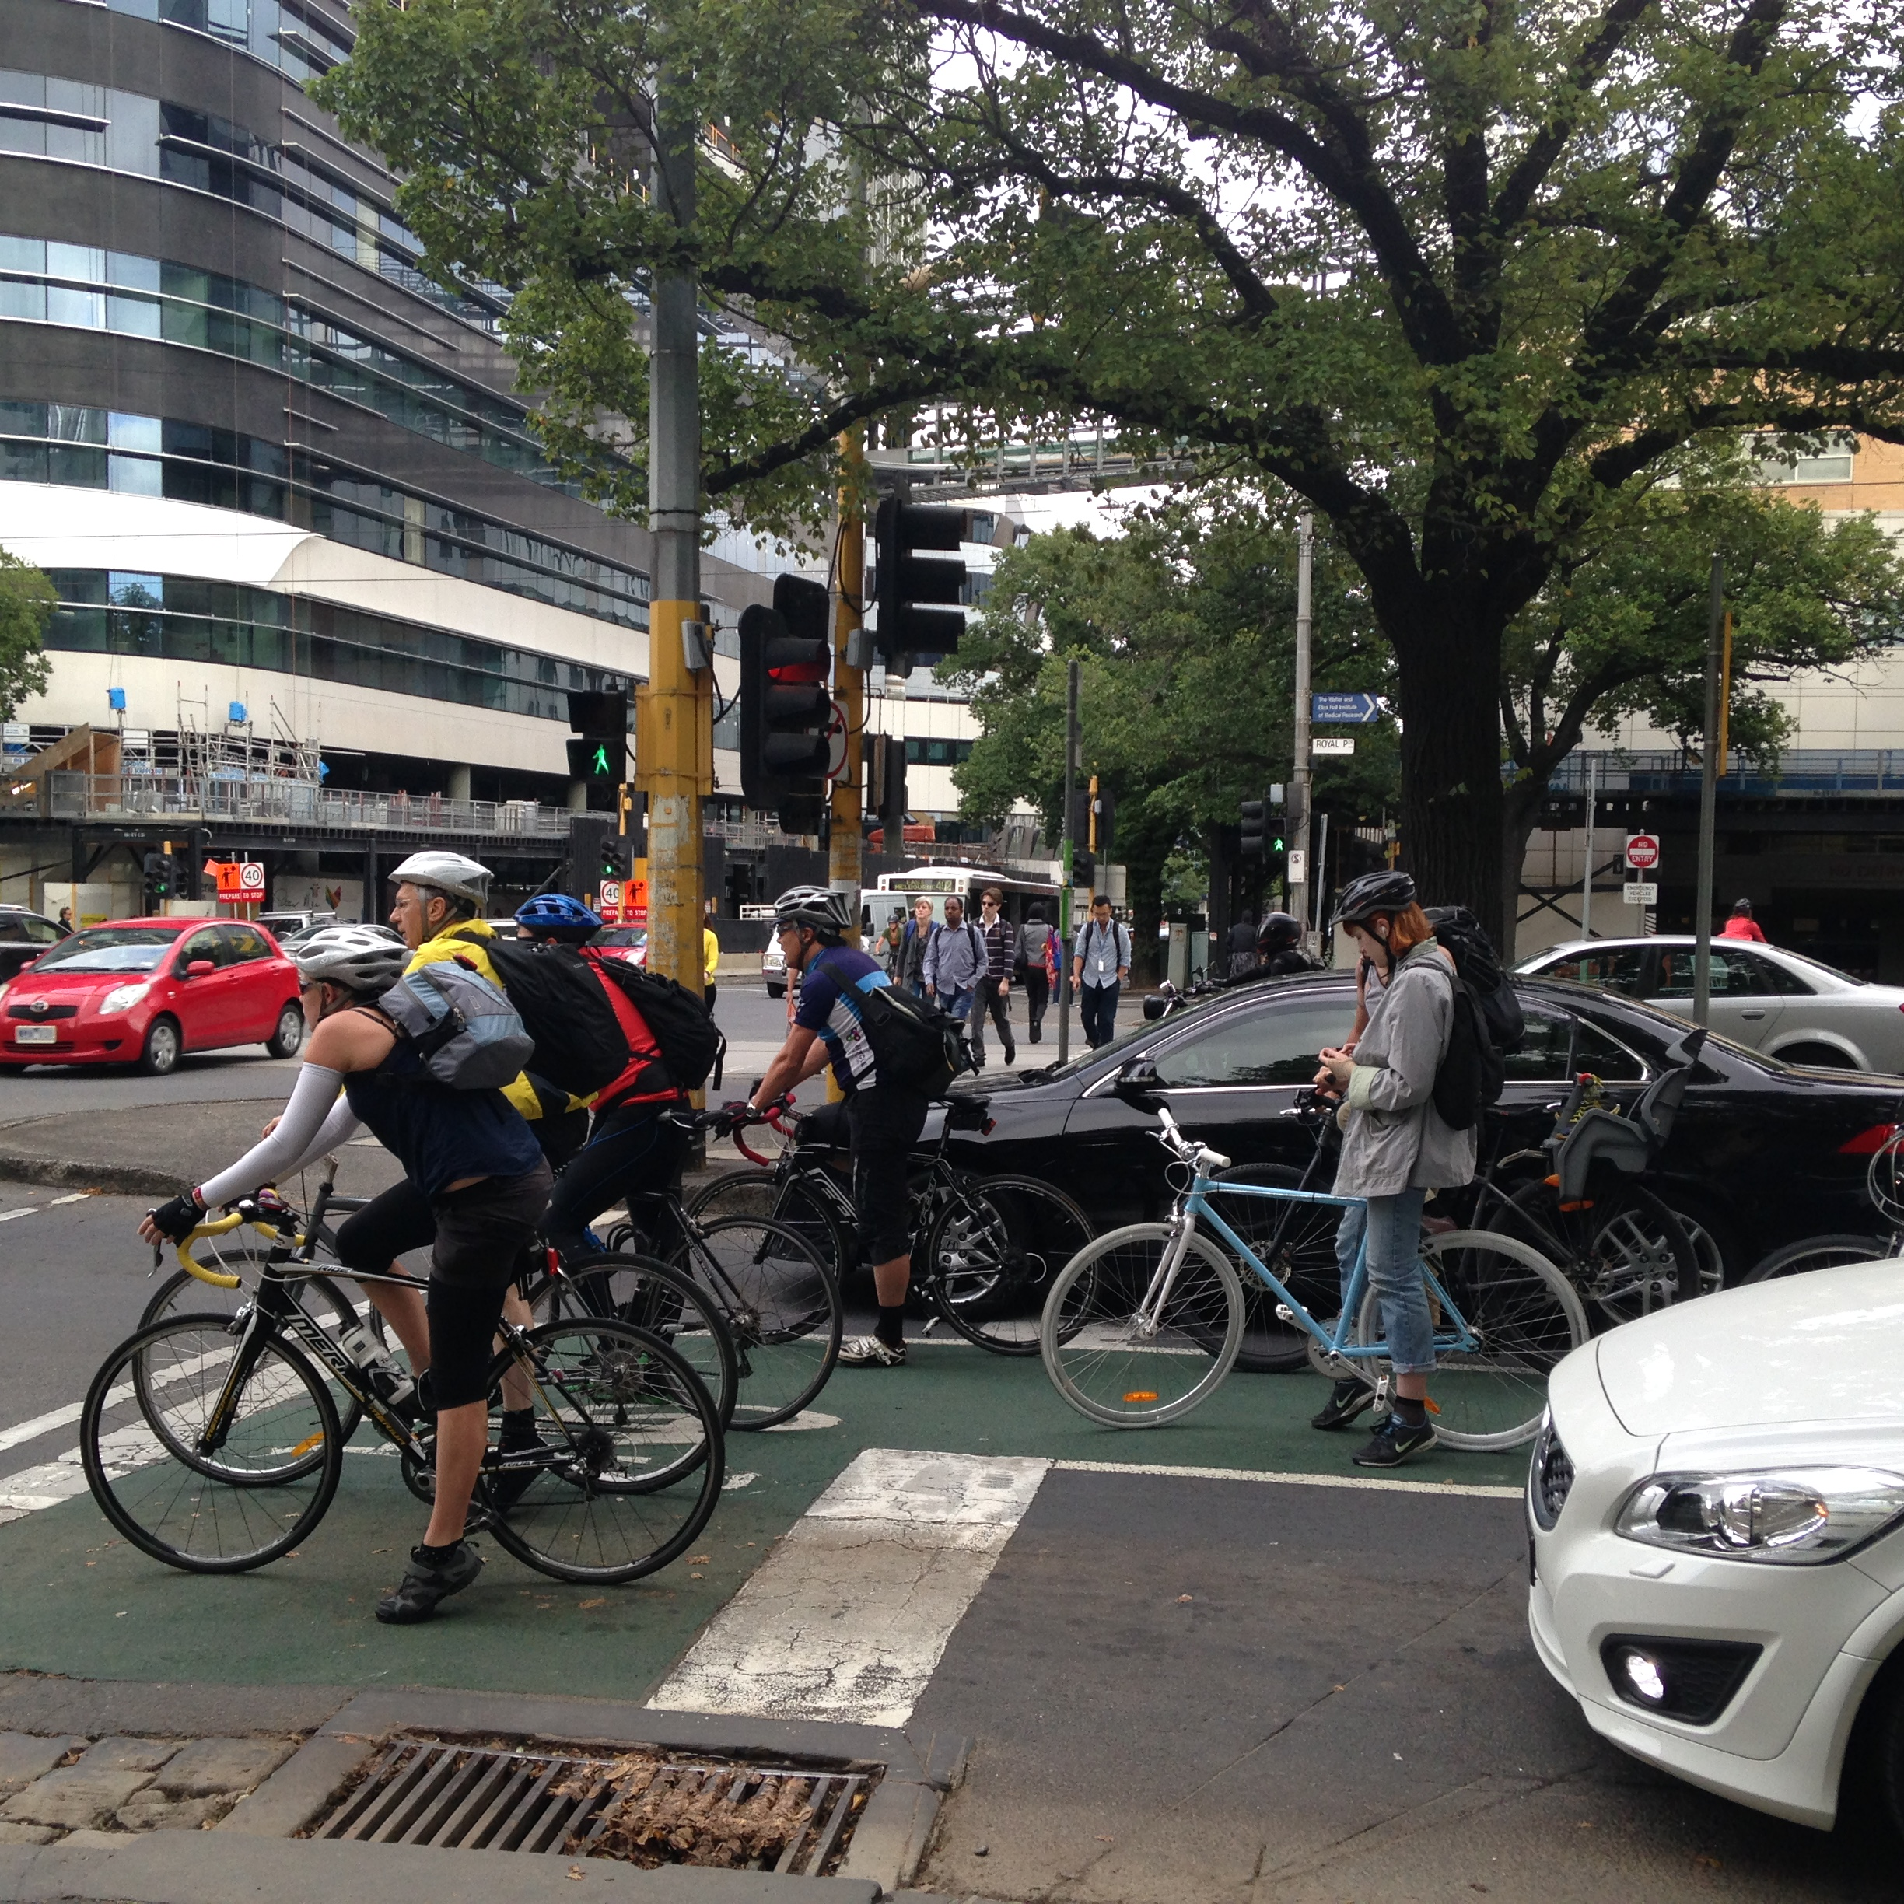
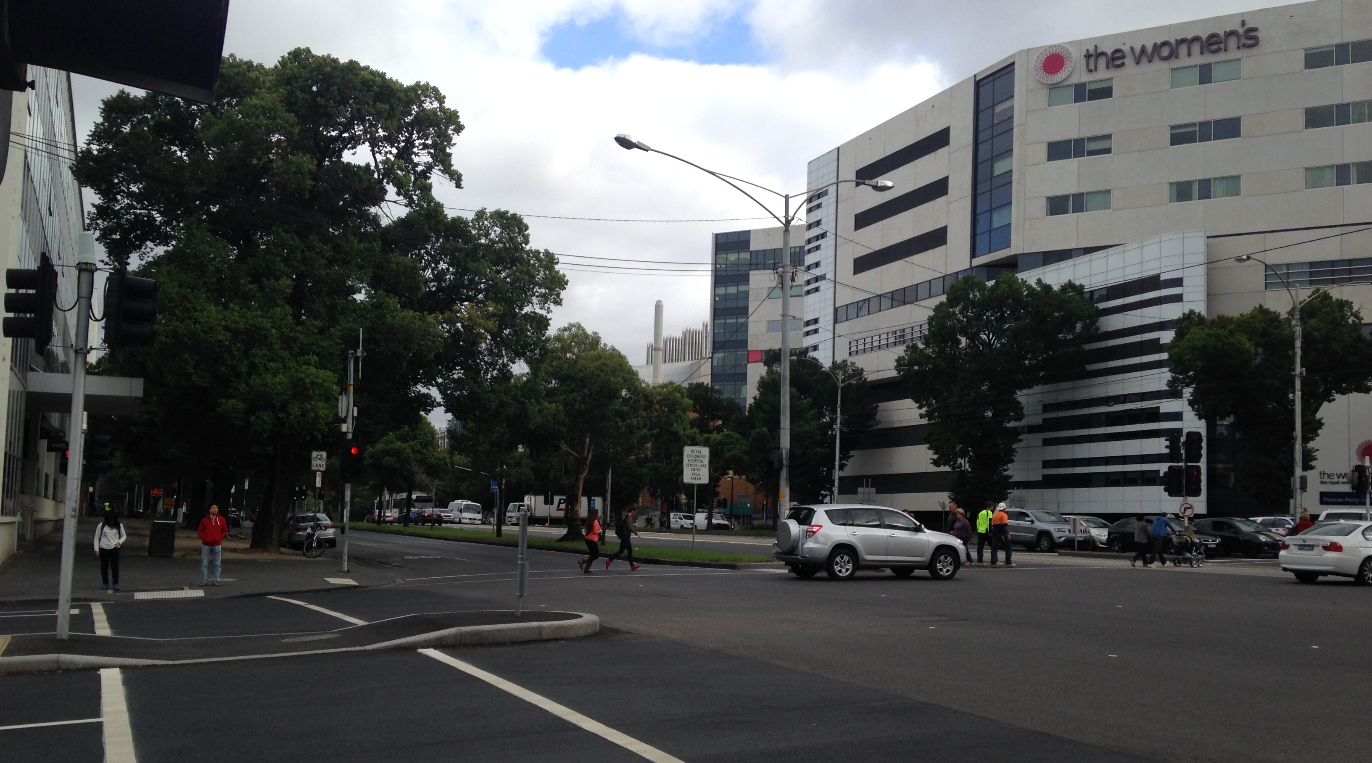
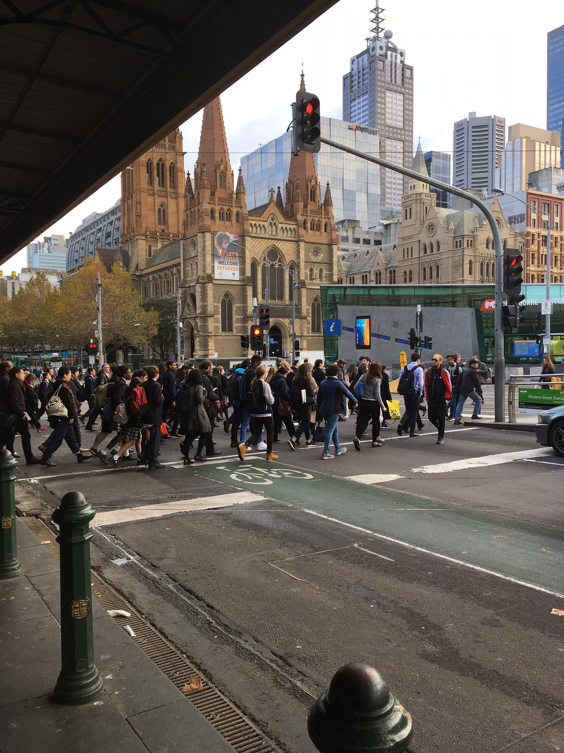
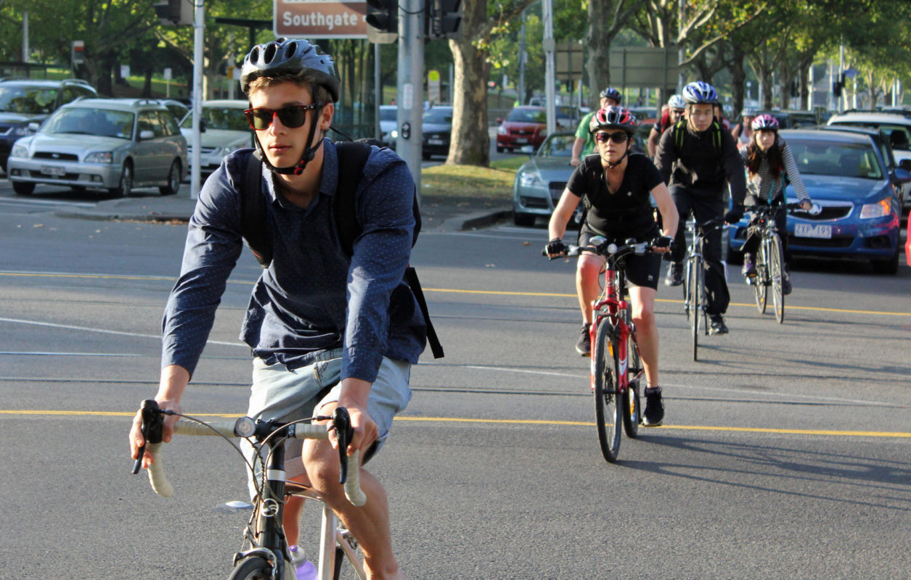
Gaps in the current route selection process
Notes:
Here is an example of a B-double gazetted road map for Melbourne CBD. The green line indicates an approved B-double route and a red line B-double banned route.
Lets assumes our worksite is located in the middle of the Melbourne CBD. The green B-double approved routes may give us an indication of suitable route for a 19m truck and dog haulage route to and from our site.
St Kilda Rd an approved B-double route. This route also carries on of the highest cyclists volumes in Australia.
Flemington Rd passes along side a major medical precinct containing the Children's Hospital, Royal Women's Hospital and Victorian Comprehensive Cancer Centre.. The road is also serviced by a tram route creating high pedestrian volumes at many of the crossings
Royal Pde passes between the medical precinct and Melbourne University. Is serviced by trams and has a busy on road bicycle lane.
These examples demonstrate that even if a road is considered geometrically suitable there may be other risks enroute that need to be considered.
So how can we identify truck routes that won’t conflict with VRU’s? In my experience in a location like Melbourne CBD it is impossible, But we can identify the risks to VRU along the routes.

Slide 7
Construction Logistics and Community Safety (CLOCS)
The CLOCS traffic routing requirements include that the:
Construction client shall ensure that a suitable risk assessed vehicle route to the site is specified and that the route is communicated to all drivers, and
Fleet operators shall ensure that any vehicle routes to sites or premises specified by clients are adhered to unless otherwise directed.
Source: TRL PPR639
Notes:
This is where I would like to return to the TFL CLOCS program. CLOCS traffic routing requirement includes a “construction client shall ensure that a suitable risks assessed vehicle route to the site is specified and communicated to all drivers”
The MTP alongside Sydney Metro Rail Project have teamed up with TFL to support the development of an Australian Version of CLOCS.

Slide 8
Introducing HIRA
Notes:
To support this our working group has developed HIRA – The Human Impact Route Assessment Process.
HIRA is a collaborative decision support process to evaluate potential truck routes through our cities with a focus on VRU.

Slide 9
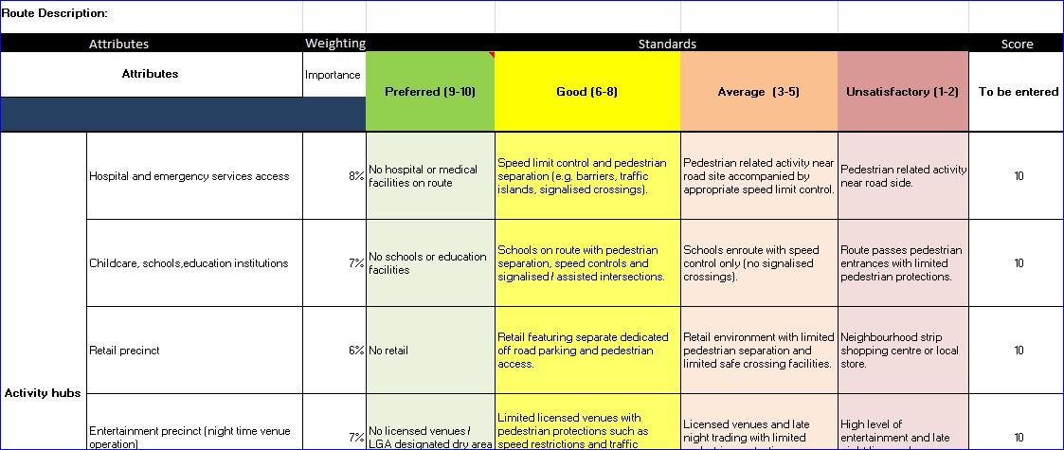
The TOOL
Performance Standards
Less than Average (1-2)
Descriptor
Attributes
Elements
Score
Notes:
HIRA draws on the collective knowledge of local experts from Council, road authorities, the contractor and developer.
Together these people use the HIRA tool, currently a weighted scoring rubric, to rate various elements within each of the four attribute areas.

Slide 10


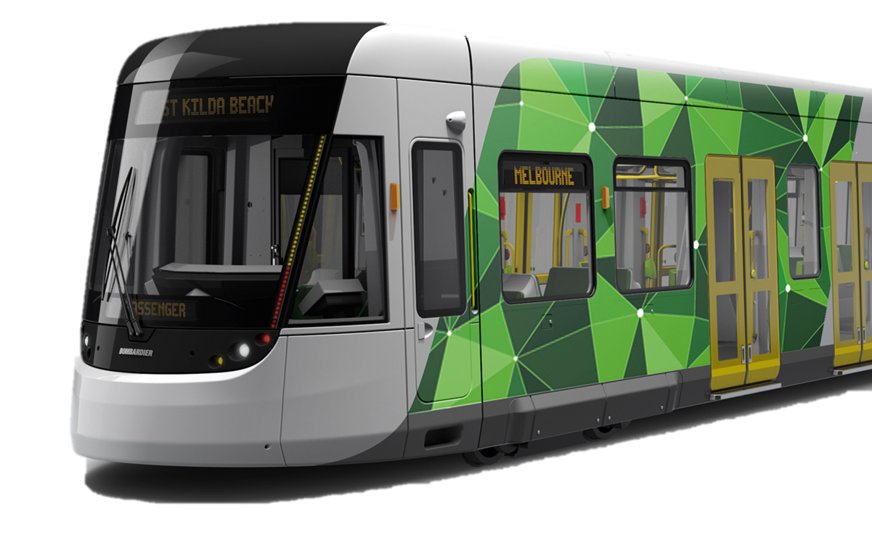

Introducing HIRA – Attributes and elements
Route Dynamics
Flexibility – ease of access to alternatives
Distance and directness (inc. number of turns required of trucks)
Conflict with other construction projects
Road types and function
Active transport (cycling / skateboards etc)
En route holding / staging areas
Activity Hubs
Hospital or emergency services access
Childcare, schools, education institutions
Retail precinct
Entertainment precinct (night venue operation)
Sporting and recreational precinct / facility
Service access and trader deliveries
Route Dynamics
Flexibility – ease of access to alternatives
Distance and directness (inc. number of turns required of trucks)
Conflict with other construction projects
Road types and function
Active transport (cycling / skateboards etc)
En route holding / staging areas
Activity Hubs
Hospital or emergency services access
Childcare, schools, education institutions
Retail precinct
Entertainment precinct (night venue operation)
Sporting and recreational precinct / facility
Service access and trader deliveries
Public Transport
En route public transport
Stops / station
Public Transport
En route public transport
Stops / station
Road Closures/Events
Intermittent road closures (LGA, VicRoads) – for events, protests, festival or works
Notes:
The attributes considered within HIRA are:
Activity Hubs, these are places where high pedestrian activity is expected day and night,
Route dynamics – which considers physical elements of the routes such a number of left turns along the route
Public transport and
Road closures/events to identify if the route will always be operational.

Slide 11
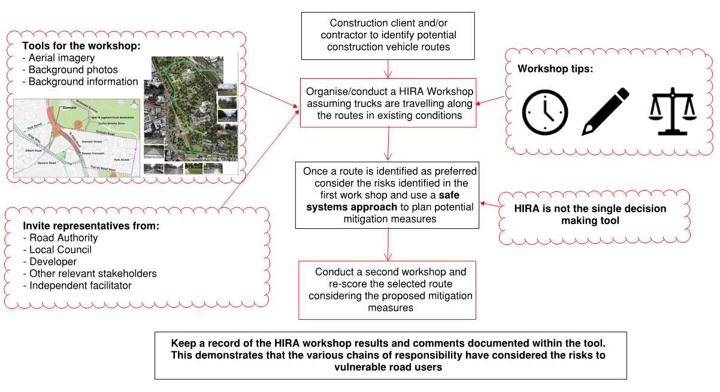
Process
Notes:
In a workshop environment the attendees tap into their own knowledge as well as other available information to score each of the elements. The key is that all members of the workshop need to agree on the score. This generates discussion around the risks to VRU’s, that may not be immediately evident to someone selecting a truck route from a map in an office on their own.
For more details about the first version of the HIRA process and tool please refer to our conference paper or come and speak to me.

Slide 12
Pilot study Participants
MTP
Moreland
Notes:
The HIRA Process and tool were piloted on two projects. The MTP a major infrastructure project in the heart of Melbourne and a Mixed multi-storey private development in an inner city suburb. Matthew our next speaker was an independent reviewer who attended all workshops to evaluate the process.

Slide 13
Pilot study key evaluation questions
Did HIRA Perform Positively in the Pilot Study?
Did HIRA Perform Positively in the Pilot Study?
Did HIRA support and affect collaborative decision-making on route selection?
Can HIRA be of value to participants?
Did HIRA support and affect collaborative decision-making on route selection?
Can HIRA be of value to participants?
How can HIRA be further developed?
Did HIRA support and affect collaborative decision-making on route selection?
Notes:
The main research question for my thesis was:
However, as this is such a broad question, it was broken down into three Key Evaluation Questions that could be more easily answered.
As HIRA is developed to aid collaborative decision-making, the first of the Key Evaluation Questions asks if HIRA does what it is intended to do.
The second key evaluation question aims to determine if participants thought HIRA is of value, as if they did not think HIRA is of value, then it is unlikely that HIRA would be used past the pilot
One of the more important outputs from the pilot study would be what can be done to further improve HIRA. Hence the third key evaluation question aims to capture how HIRA can be further developed to meet the two objectives defined in the first two key evaluation questions.

Slide 14
Pre-workshop questionnaire
Diversity of stakeholders
Route preconceptions
Expected benefits
Perceived gaps
Diversity of stakeholders
Route preconceptions
Expected benefits
Notes:
There were three methods for collecting data as part of the pilot study. The first of these was a pre-workshop questionnaire that was filled at the start of the initial workshop with each group. The questions were written with answering the key evaluation questions in mind.
The first question looks at the diversity of stakeholders in the workshop and what role each would perform in the business as usual case.
The second question helped identify factors that participants considered when assessing the route without using HIRA.
We asked the third question to determine what participants expected from conducting a HIRA workshop and how that aligned with what HIRA was intended to do.
The fourth question performed a similar task to question three, but focusing on what participants believed was missing from HIRA, rather than just the benefits.

Slide 15
post-workshop questionnaire
Perceived value of HIRA
Perceived gaps
Comparison with Business as Usual
Perceived value of HIRA
Perceived gaps
Comparison with Business as Usual
Further development
Notes:
The second method of data collection was the post-workshop questionnaire, which was 8 questions long. Once again, these questions were written with the key evaluation questions in mind.
The first three questions focus on the perceived value of HIRA. The first looks at if the participant agreed with the result, the second looks at if HIRA fulfilled it’s intent while the third asks participants what they thought the benefits were and how that differed from what they expected.
The fourth question asks participants if they thought there were gaps in the tool. Although asked in the pre-workshop questionnaire, it is asked again here to allow participants to answer again now that they had used HIRA.
The Fifth question is asked as a comparison between business as usual and with a HIRA workshop.
Question six through to question 8 all focus on further development of the tool. Question 6 has a focus on the descriptors, question 7 has a focus on the process and question 8 gives participants to suggest any other improvements not covered in the other questions.

Slide 16
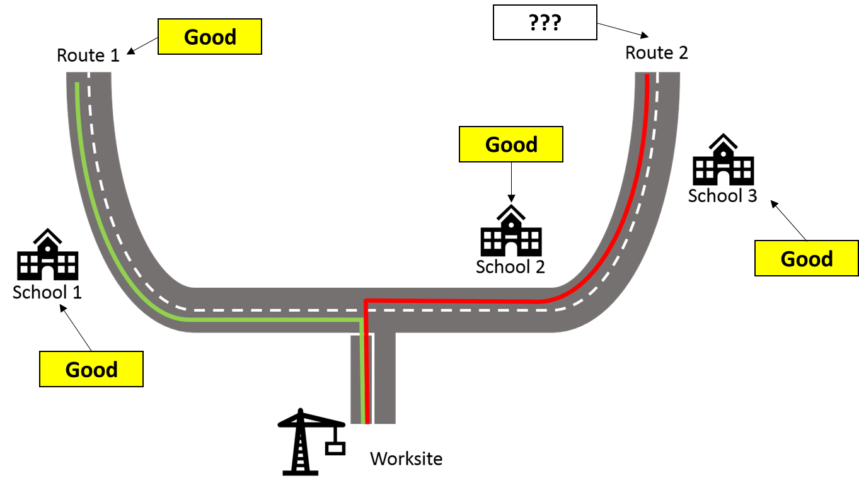
Critiques (KEQ 3)
Liability
Time
Liability
Time
Language
Notes:
The third data collection method was observations during the workshop. While the pre and post-workshop questionnaires were only asked on the initial workshop, observations were taken at all workshops allowing for comparisons of participant perceptions after exposure to the tool.
Results from the questionnaires as well as from observations in the workshop were positive, showing that participants thought that conducting HIRA workshops were of value. However, there were six issues that were raised either in the questionnaires or as observations in the workshop.
The first was liability, with HIRA identifying risks, it also created liability issues as to who is responsible for mitigation.
The second was time taken, HIRA workshops took around two hours for the initial workshop, though it was noted that the time dropped to around an hour and fifteen minutes on subsequent workshops.
There was some confusion over the wording of the descriptors of certain elements, some not aligning with VRU safety, while others were questioned as irrelevant to VRU safety at all.
Although stakeholder engagement was generally considered one of the more valuable aspects of HIRA, some concern was expressed that local residents and public transport authorities were not invited to HIRA workshops.
Scoring sometimes proved difficult when comparing routes with different levels of exposure but the same severity.
The final concern was that HIRA did not factor local residents into the assessments of the routes.

Slide 17
recommendations
Improve introduction to HIRA
Re-word descriptors
Re-order attributes
Improve introduction to HIRA
Re-word descriptors
Notes:
Tying these results back into the three key evaluation questions, we can determine the success of the pilot study.
Firstly, starting with the areas for improvement, there are three recommendations arising from the pilot study. The first is that the introduction of HIRA needs to be refined to ensure that participants understand the intent of HIRA. This is evident from participants expecting HIRA to include things such as local residents considerations and congestion as part of the assessment, even though both of these are outside the intent of HIRA. This will also alert participants to the relatively slow pace of HIRA, especially at the start of the workshop.
The second recommendation is to re word descriptors that have been highlighted in workshops as either too vague, irrelevant, or not aligned with VRU safety.
The third recommendation is the re-order the attributes so that route dynamics is done first so that engineers get accustom to HIRA using elements that they are familiar with before assessing routes with regards to elements that may not be so familiar, such as the ones in activity hubs.
Addressing the collaborative decision-making key evaluation question, the multi-agency discussion that occurred within the HIRA workshop was met with praise from all involved. Many participants commented that they gained information from other agencies that they may have otherwise overlooked.
Finally, addressing the value of HIRA, participants found that they were identifying new risks along the assessed routes. Participants also commented that HIRA can be used as proof of a risk assessment along the route. It was also noted during subsequent workshops that participants were giving VRUs greater consideration when devising routes to bring to the workshop, creating less work to be done during the workshop.

Slide 18
KEQ 1 & 2 results
Benefits of Collaborative Decision-making
Value of HIRA
Multi-agency discussion
Information sharing
Multi-agency discussion
Information sharing
Risk identification
Proof of risk assessment
Inclusion of VRU safety in decisions
Risk identification
Proof of risk assessment
Notes:
Tying these results back into the three key evaluation questions, we can determine the success of the pilot study.
Firstly, starting with the areas for improvement, there are three recommendations arising from the pilot study. The first is that the introduction of HIRA needs to be refined to ensure that participants understand the intent of HIRA. This is evident from participants expecting HIRA to include things such as local residents considerations and congestion as part of the assessment, even though both of these are outside the intent of HIRA. This will also alert participants to the relatively slow pace of HIRA, especially at the start of the workshop.
The second recommendation is to re word descriptors that have been highlighted in workshops as either too vague, irrelevant, or not aligned with VRU safety.
The third recommendation is the re-order the attributes so that route dynamics is done first so that engineers get accustom to HIRA using elements that they are familiar with before assessing routes with regards to elements that may not be so familiar, such as the ones in activity hubs.
Addressing the collaborative decision-making key evaluation question, the multi-agency discussion that occurred within the HIRA workshop was met with praise from all involved. Many participants commented that they gained information from other agencies that they may have otherwise overlooked.
Finally, addressing the value of HIRA, participants found that they were identifying new risks along the assessed routes. Participants also commented that HIRA can be used as proof of a risk assessment along the route. It was also noted during subsequent workshops that participants were giving VRUs greater consideration when devising routes to bring to the workshop, creating less work to be done during the workshop.

Slide 19
Looking head……
Tool refinement
Web interface linking to other government resources
Tool governance
Notes:
The Process
Findings from the trial will inform refinements to the process used up to now to administer HIRA. This process includes the forum in which the tool is completed, the sequence of attributes assessment, the means of achieving collaboration between parties, and the tool’s integration into project requirements. An optimum process will shorten the time that route scoring takes and emphasise the collaboration between parties, particularly in identifying risk mitigation.
Tool Presentation
The working group is developing an internet-based interface for HIRA. The information architecture and design of the web platform will assist to sustain the fidelity of the tool’s administration. The step-by-step approach will be consistent with the decision support tool and will include illustrative or photographic examples of performance standard descriptions. Additional functionality will include online collaboration and integration with geo-spatial information systems and relevant transport map layers. The working group is mindful that data collection is a highly sensitive issue and will be approached to ensure parties will confidently engage with the tool without fear of the tool data being used to proportion blame for any incidents that may occur.
Project governance
The working group continues to liaise with MMRA alliance membership to discuss its use for site specific assessments. Further understanding of the legal liabilities associated with use of the tool for various stakeholders will be researched. Insert comma

