Slide 1




Meet HIRA: The Human Impact Route Assessment tool and Process
CLOCS Symposium
Jamie Ross, Matt Bennett, Lydia Foster-Smith
Notes:
Good morning everyone, my name is Matt Bennett and I am a transport planner from Aurecon

Slide 2
Route Choice Working group
Route Choice Working Group (core)
Jennifer Thompson, VicRoads
Victor Trumper, VicRoads
Lora Colussi, Aurecon
Matt Bennett, Aurecon & RMIT University
Ben Phillips, VicRoads
With thanks to the following contributors:
Dane Miokovic, Melbourne Metro Rail Authority & VicRoads
Andrew Cron, City of Melbourne
Fu-Ho Chung, VicRoads
Simon Mcleish, Fulton Hogan
Kenn Beer, Safe Systems Solutions
Johann Tay, Safe System Solutions
Notes:
I am here representing a working group that has been tasked prioritising Vulnerable Road Users, or VRU safety by improving truck route selection processes.

Slide 3
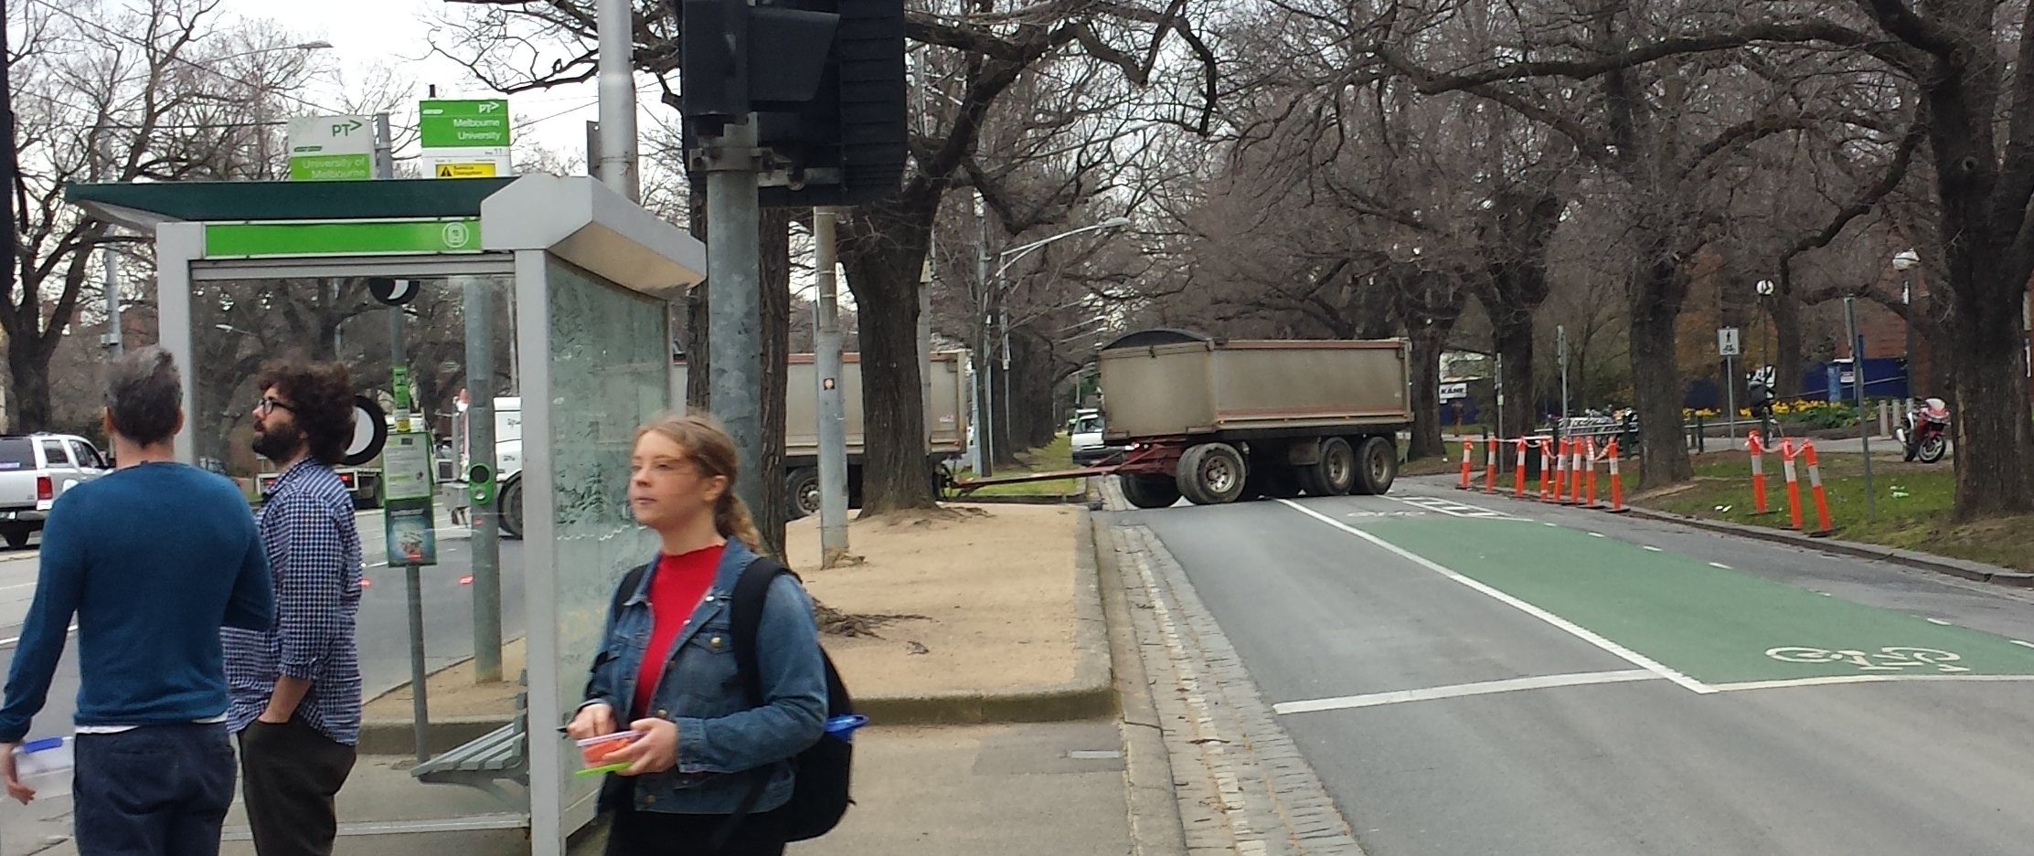
Current Route Selection Practice
Notes:
In Victoria, as well as other states and territories, a 19m articulated truck, or truck and trailer can travel on any road, arterial or local, unless that road is subject to a load limit. As a result, the industry will often select the quickest route to and from a site, limited only by physical or geometric constraints on the road.

Slide 4
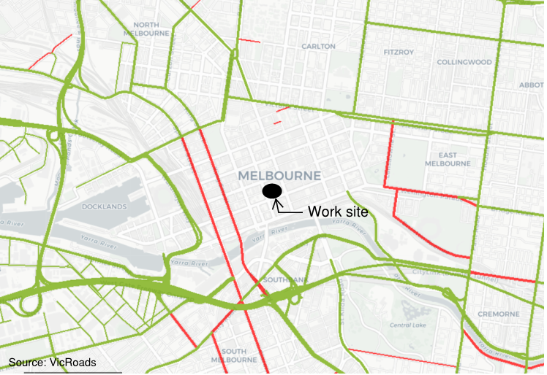
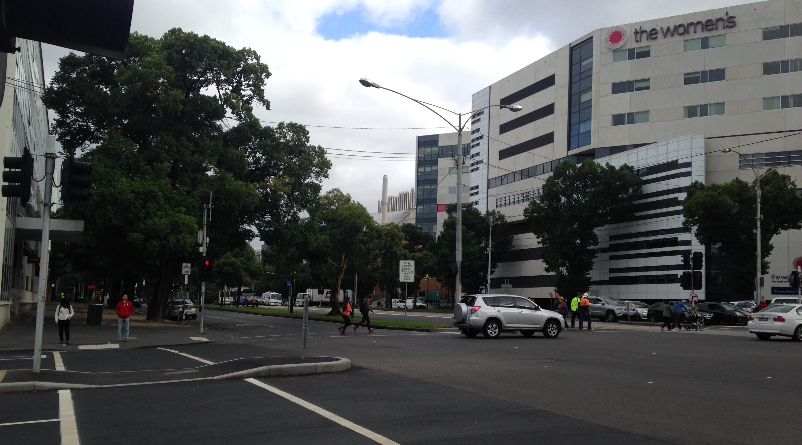
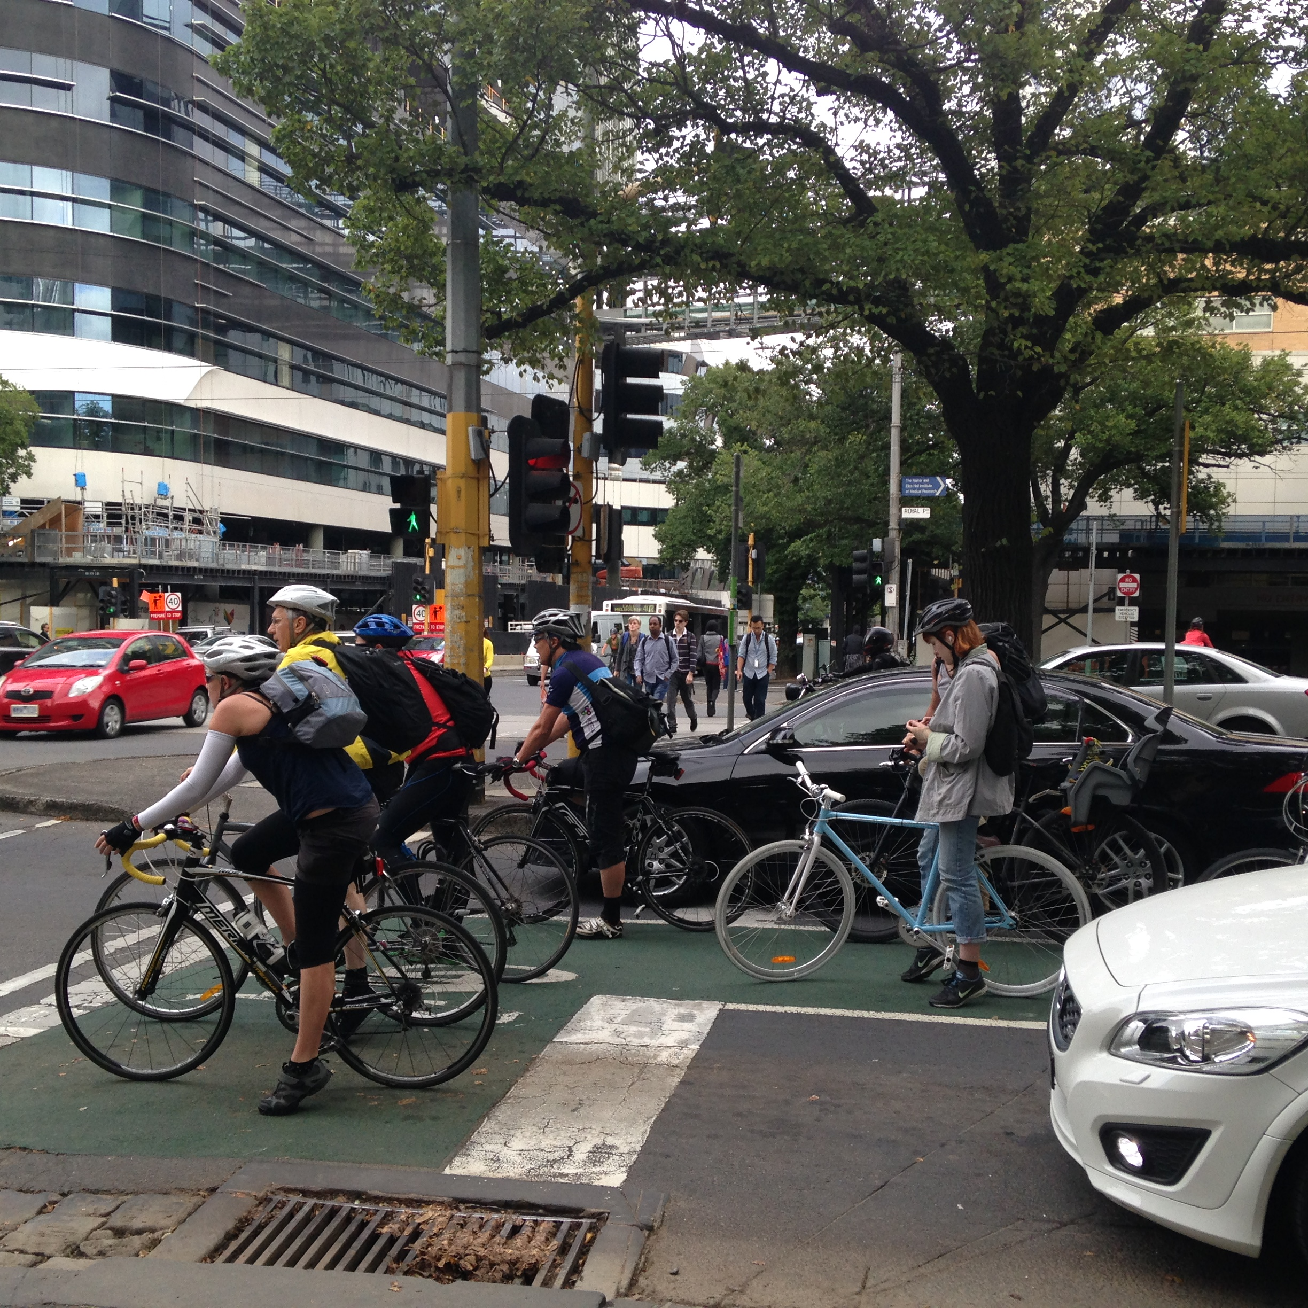
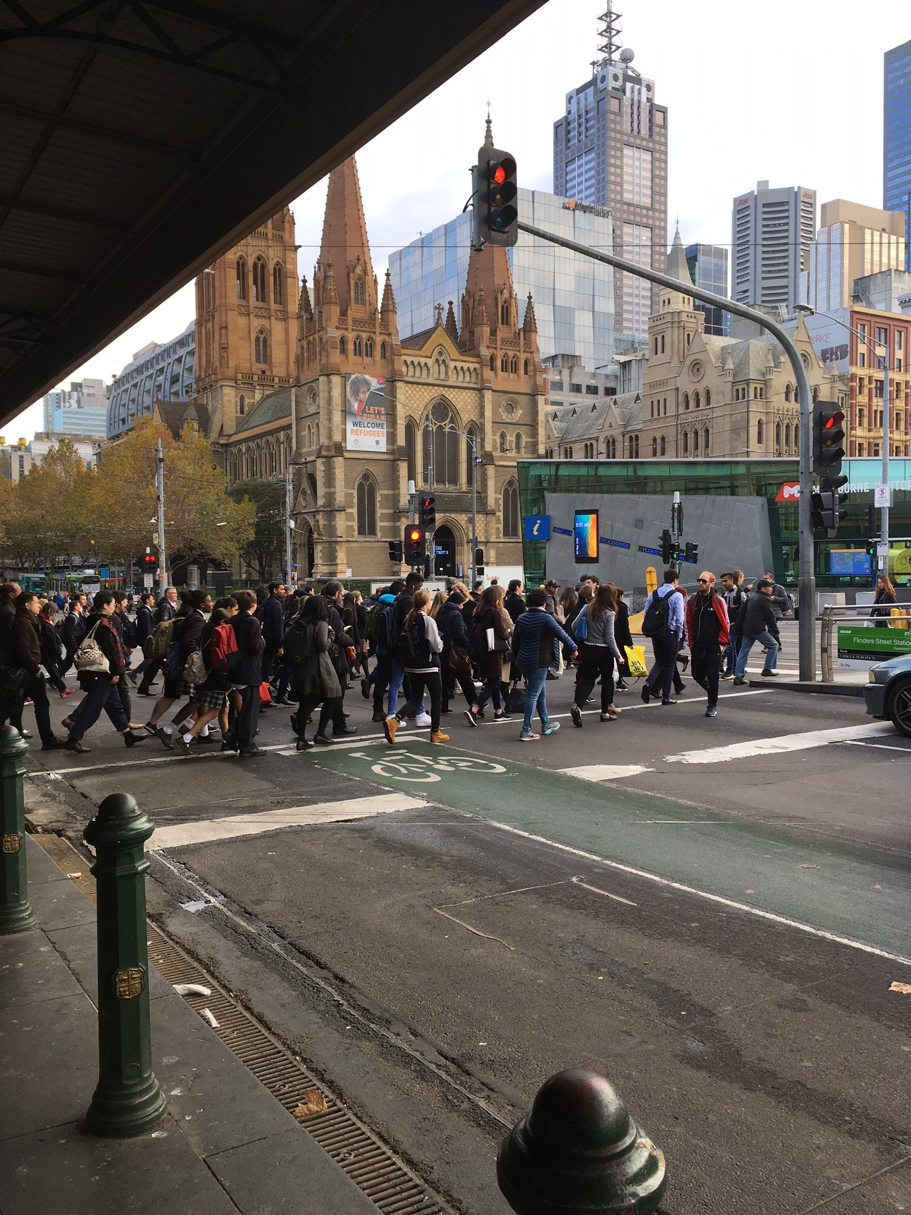
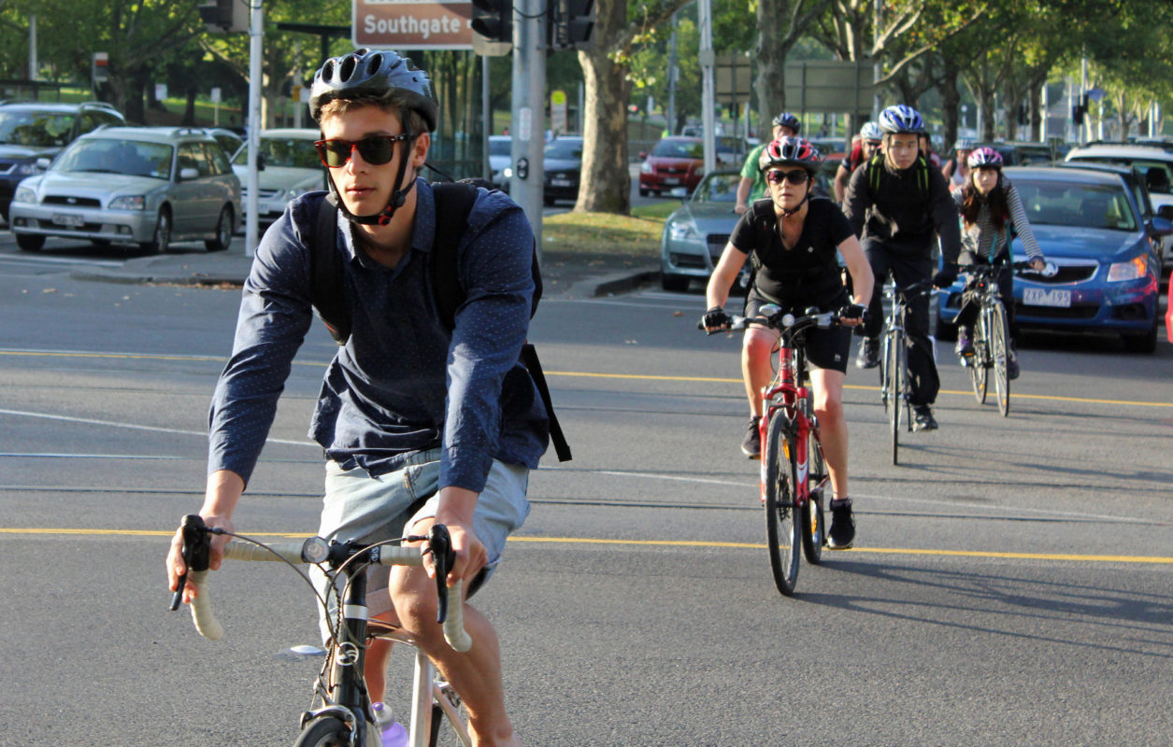
Heavy Vehicle Network Maps
Notes:
Road authorities such as VicRoads provide information on the suitability of roads in the form of Heavy Vehicle Network Maps. These maps show roads that are approved and restricted for certain truck types. These maps give a good indicator as to which roads are geometrically suited for trucks. However, especially with regards to safety, there is more to consider rather than just geometry.
Let’s assume we are trying to find a suitable route to a worksite in the centre of Melbourne’s CBD. I have taken a screenshot of the gazetted B-Double network around the site from the VicRoads Website. Immediately we can see the first problem with the heavy vehicle network maps: Not every road has been gazetted, so we can’t get to the site along the green lines alone. What about the roads that are already gazetted? That should be easy, green equals good roads, red equals bad roads. Unfortunately, it can be a little more complex than that.
For example, Saint Kilda Road, a B-Double approved road, carries one of the highest cyclist volumes in the Australia, and the highest volume of trams in the world.
To the north, Flemington Road passes a major medical precinct, passing the Royal Children’s Hospital, the Royal Women’s Hospital and the Victorian Comprehensive Cancer Centre.
Royal Parade, the road in the photo on the previous slide, passes the medical precinct, the University of Melbourne and a high school.
If we were to continue along Saint Kilda Road to get to our site, we would come to the intersection of Swanston Street and Flinders Street, one of the busiest pedestrian intersections in Australia.
These examples demonstrate that even if a road is considered geometrically suitable, there may be some other risks on the route that should be considered.
So, can we identify truck routes that won’t conflict with VRUs? In a location like Melbourne’s CBD, it is unlikely to say the least, but we can identify the risks along the route.

Slide 5
TRL Report
Road risk is less important than general health & safety risk
Lack of ownership of road risk by principal contractors
Route planning to avoid cyclists is especially difficult in construction projects due to the transitory nature of sites
Source: TRL PPR639
Notes:
This problem is by no means unique to Melbourne or even Australia. Over in the United Kingdom Transport for London commissioned a report from the Transport Research Lab looking into the impacts of construction related traffic on cyclists. I won’t go into too much detail about this report, but I would like to draw your attention to three of the findings of the report.
The first is that road risk is often perceived as less important that general health and safety risks.
The second is that there is a lack of ownership of road risk by principle contractors, which is an issue that is prevalent in Australia too.
The third, and arguably most important for this presentation, is that route planning to avoid cyclists is especially difficult in construction projects due to the transitory nature of sites.

Slide 6
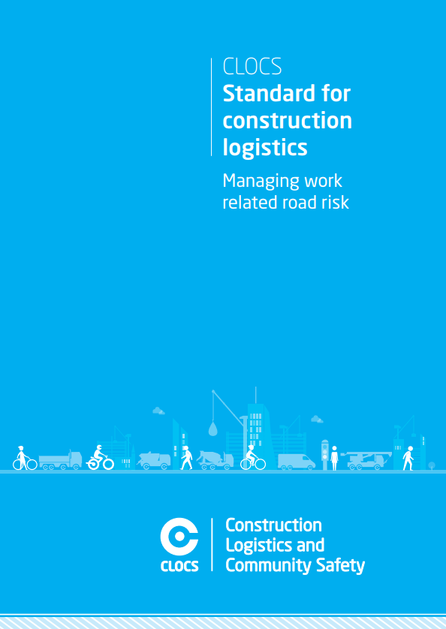
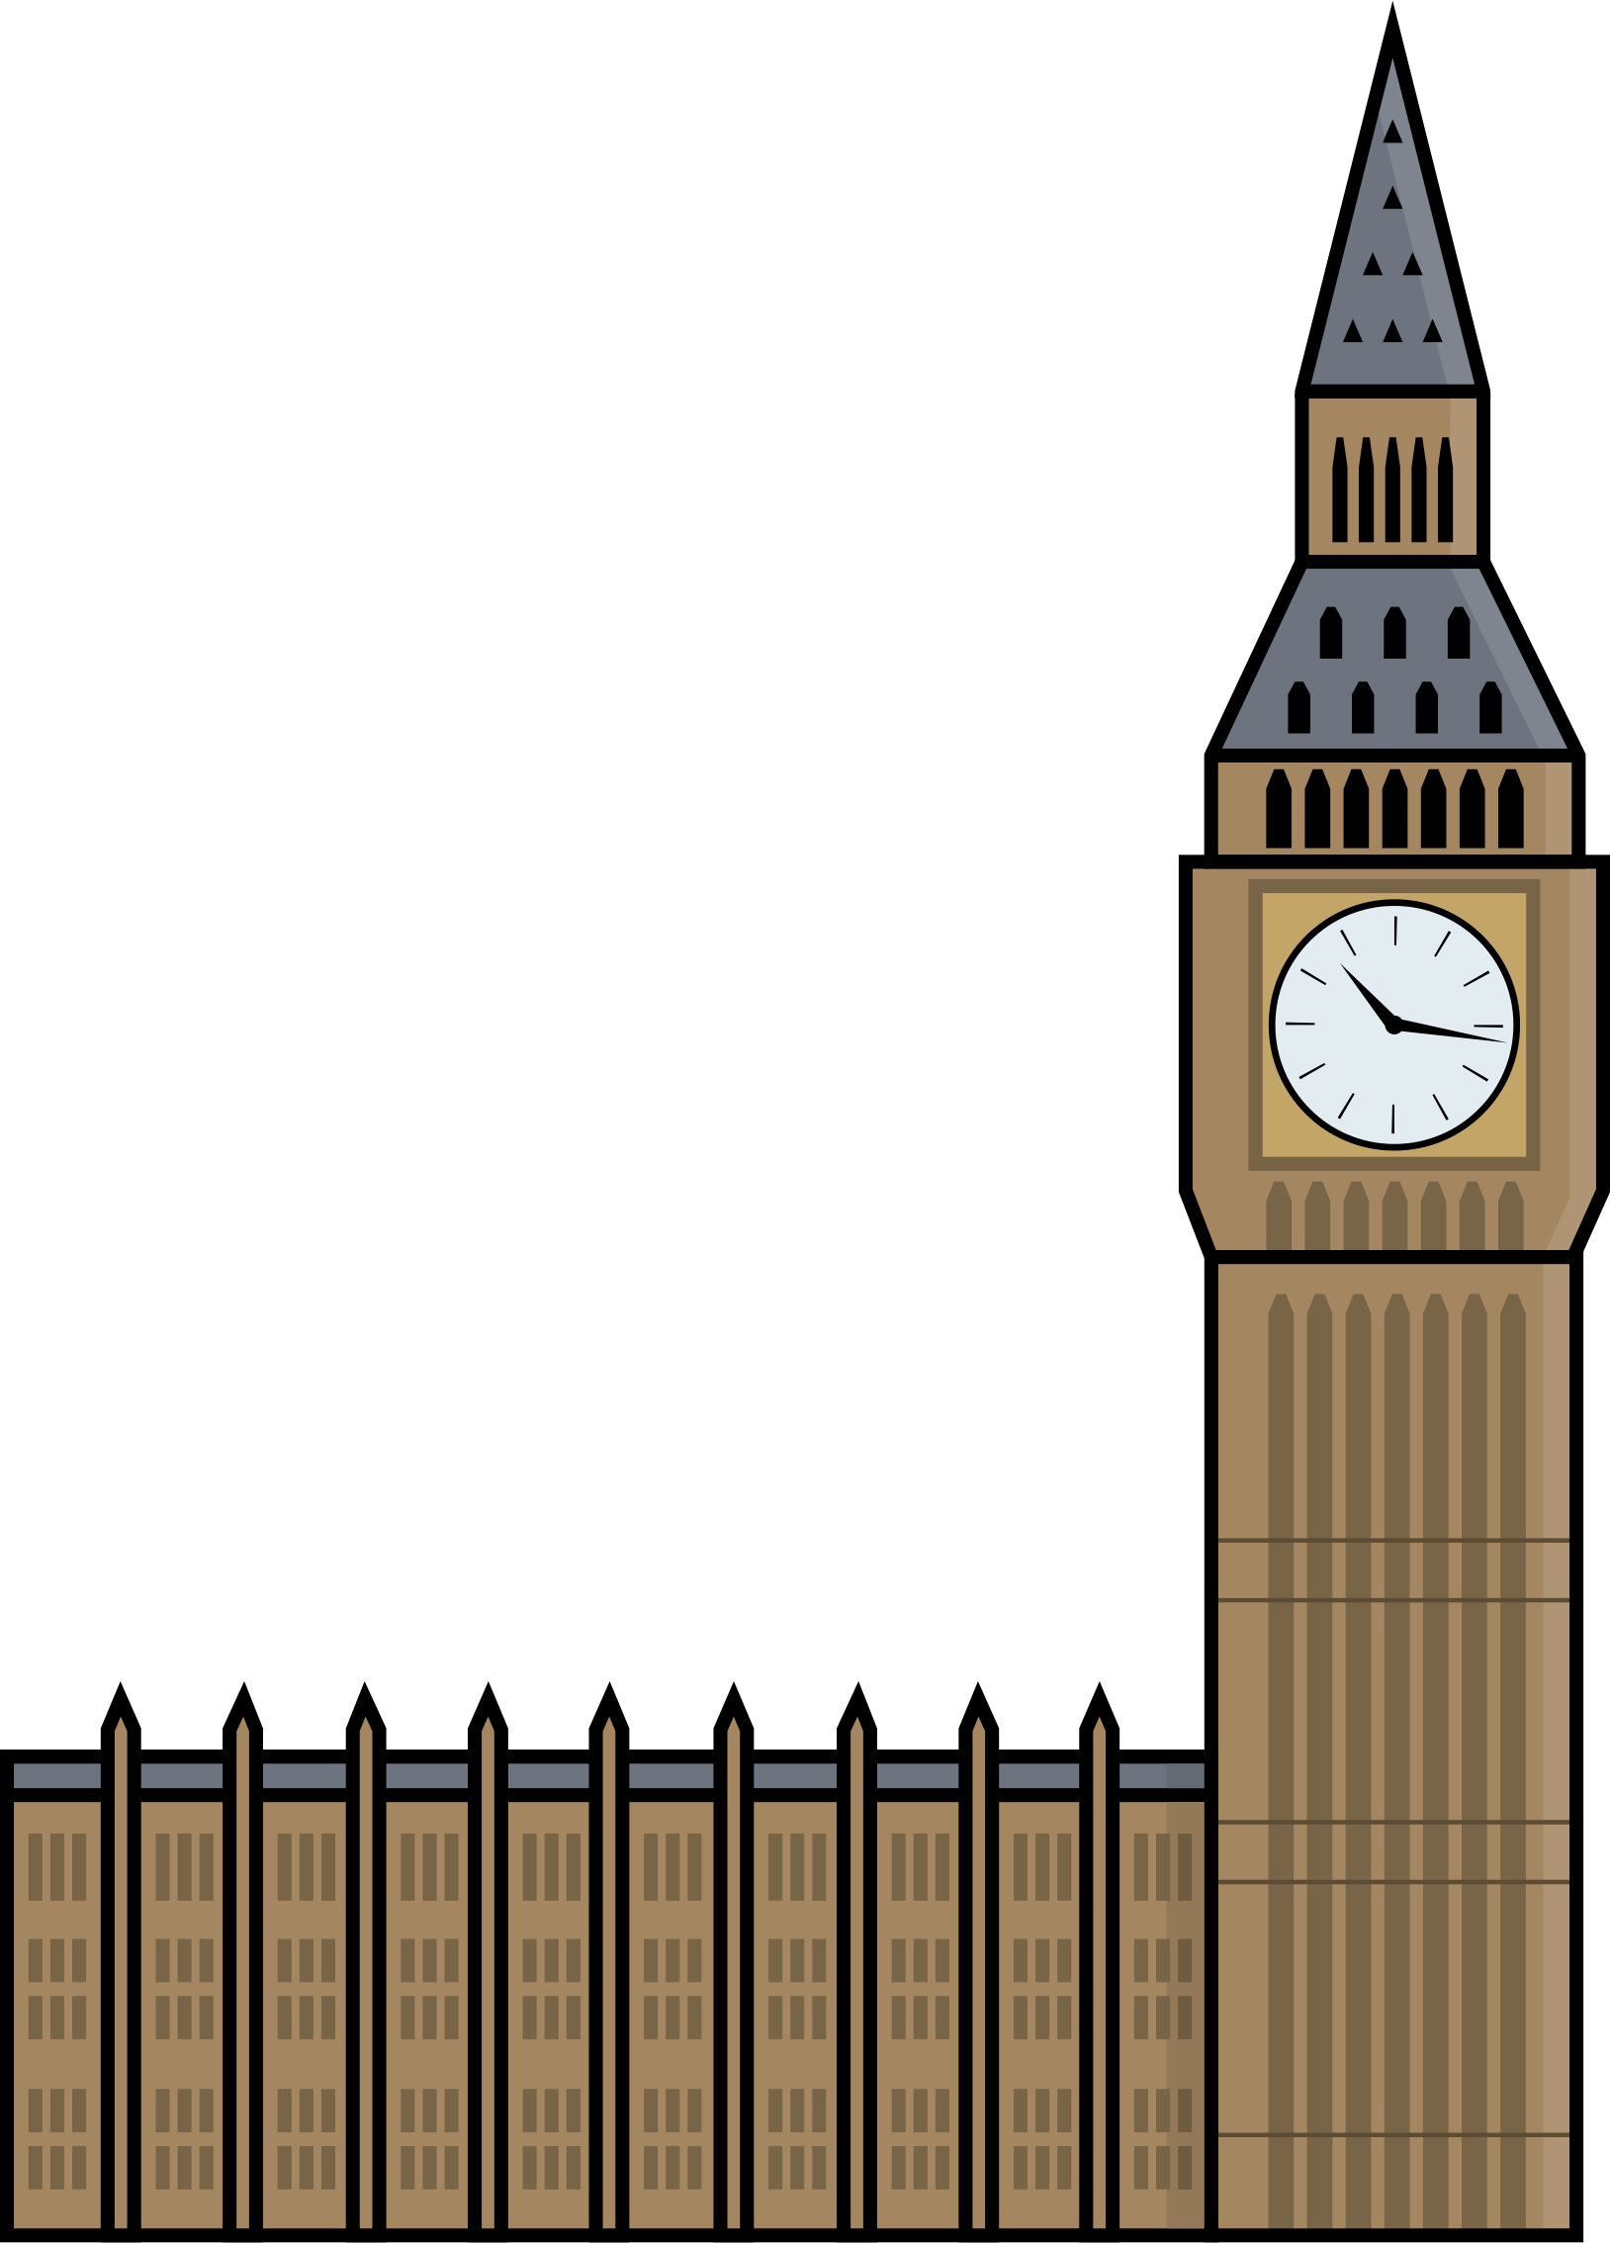
TfL and Their CLOCS
Requirement 3.1.5: Clients shall ensure that a
suitable, risk assessed vehicle route to the site is
specified and that the route is communicated to all
principal contractors and drivers. Clients shall
make principal contractors, fleet operators and
other service suppliers aware that they are to
use these routes at all times unless
unavoidable diversions occur.
Requirement 4.1.3: Fleet operators shall
ensure that any vehicle routes to sites or premises
specified by clients are adhered to unless directed
otherwise.
Notes:
Based on a review from the Transport Research Lab, Transport for London created their Construction Logistics and Community Safety, or CLOCS program. The CLOCS standard as part of the program has two requirements that are relevant to heavy vehicle route selection. The first, requirement, number 3.1.5, requires clients to risk assess routes and communicate this to the contractors. The second requirement, number 4.1.3, requires the fleet operators to adhere to these routes.
However, CLOCS does not provide any guidance on how routes should actually be risk assessed.

Slide 7

Introducing
A Decision Support Tool for Major Construction Project Traffic Planning
Notes:
This is where HIRA fits in, the working group which I am a part of has developed HIRA to provide a structured process to risk assess routes with a focus on VRUs.

Slide 8


Introducing HIRA
Collaborative Decision Support Process & Tool
Step by step risk assessment
Focus on VRUs
Notes:
HIRA is designed to be used in a workshop with relevant stakeholders. This can include, although not exclusively, clients, contractors, road authorities and local government.
HIRA forces participants of the workshop to look at potential hazards along the route, and while route planners may subconsciously consider some of these hazards when planning routes, conducting a HIRA workshop makes a formal record of the identified hazards as well as initiates discussions with other agencies about what can be done about them.
Often, the effects a route may have on VRUs is overlooked during the route selection process. HIRA focuses solely on VRUs , bringing safety to the forefront to the route selection process.

Slide 9
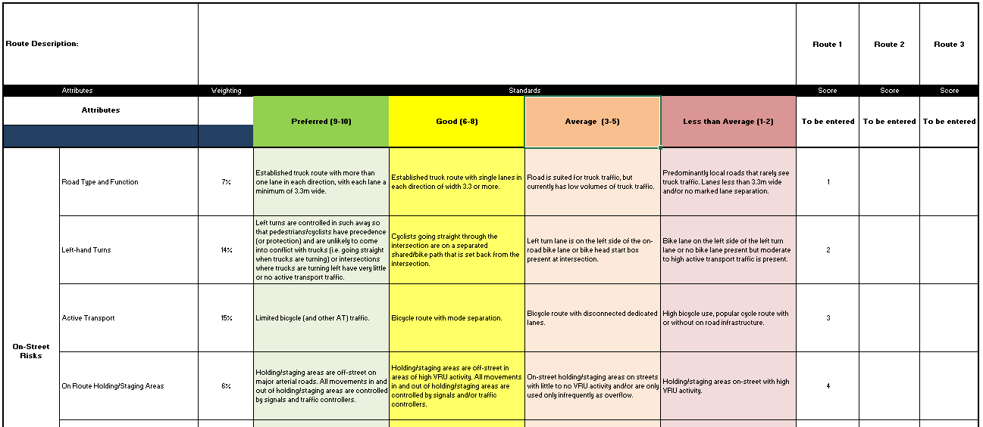
Using HIRA
Performance Standards
Descriptor
Elements
Score
Notes:
HIRA is currently conducted on an Excel Spreadsheet. Participants in the workshop score elements, against performance standards using descriptors. They must come to a unanimous score before moving on to the next route. Once an element has been scored for each route, participants then move on to the next element. If an route scores Average or Less than Average for an element, participants are encouraged to write a comment describing why that route scored so low.

Slide 10
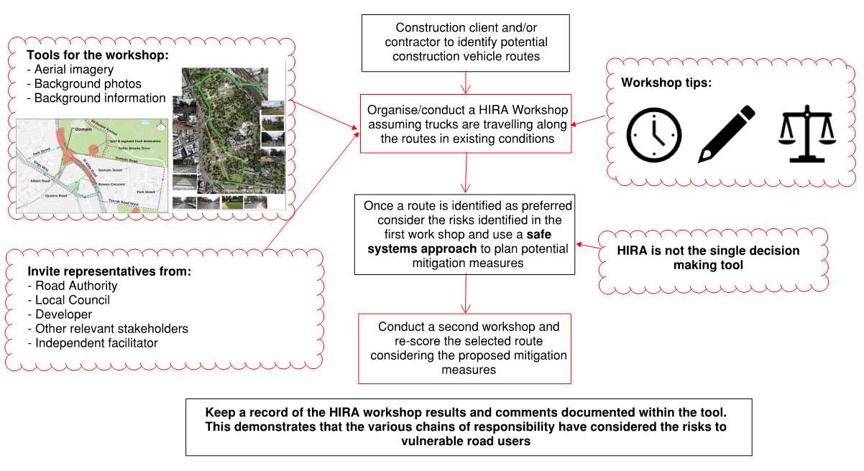
Process
Notes:
HIRA is used in a workshop environment with participants tapping into their own knowledge as well as other available information to score each of the elements. All participants need to agree on the score. This generates discussion around the risks to VRUs that may not be immediately evident to someone selecting a truck route from a map in an office on their own.
For more details on the process of HIRA, you can come find me near the HIRA poster after the symposium.

Slide 11
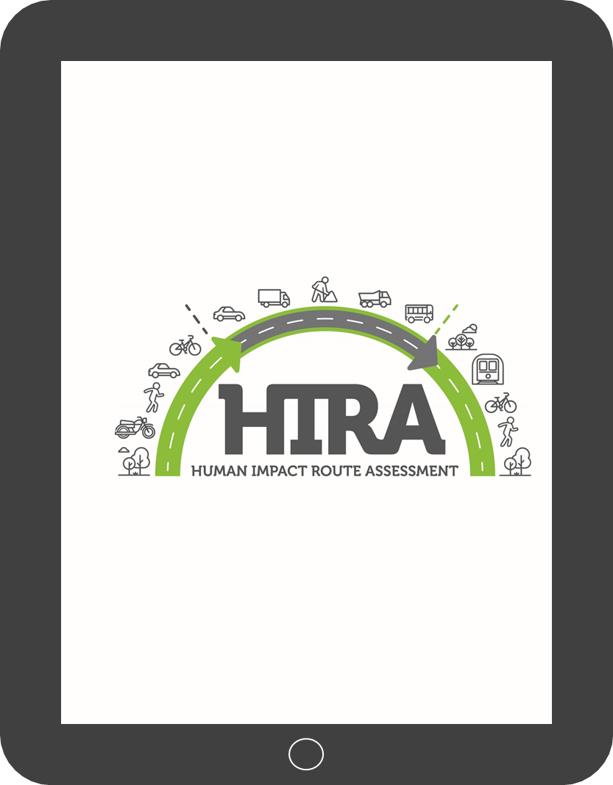
Digitising HIRA
Performs same tasks as Excel
Geo-referenced risk locations
Annotated images of risks
Auto-generated report
Notes:
Looking ahead, HIRA is being digitised and can be conducted on an iPad. As well as completing the rubric that is currently on Excel, using an app on a tablet allows participants to mark on an map where the risks are and have a photo accompany them. It will then auto-generate a report and send it to the participants in the workshop. If you are interested more in what HIRA looks like on a digital platform, come find me by the HIRA poster and I will happily demonstrate how it works.

Slide 12
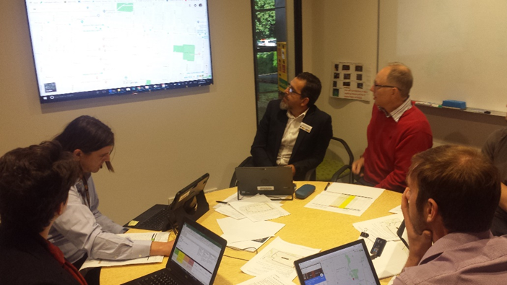
HIRA Pilot Study
Late 2017/early 2018
Focus on benefits of HIRA & identifying gaps before wider release
Notes:
Late last year to early this year, HIRA was piloted with Melbourne’s Metro Tunnel Project and a urban village development site. The study aimed to establish what were the benefits of HIRA and what could be improved. Since the completion of the study, the tool was adapted to place more emphasis on the benefits and address critiques.
Key findings from the study were that HIRA was effective at identifying risks on potential routes as well as providing a proof of risk assessment. It was also noted that HIRA was changing the way participants perceived what was and was not a suitable route. In subsequent workshops, participants had already considered where the risks were before commencing the workshop, aside from speeding up the workshop, this also shows that conducting even just one HIRA workshop can change how people see risks in the heavy vehicle route selection process.
Participants also found that the collaborative nature of the workshops was of great benefit through information sharing and ensuring that the key stakeholders were aware of where the risks were, and therefore could better understand why the final route was chosen.

Slide 13
Notes:
Late last year to early this year, HIRA was piloted with Melbourne’s Metro Tunnel Project and a urban village development site. The study aimed to establish what were the benefits of HIRA and what could be improved. Since the completion of the study, the tool was adapted to place more emphasis on the benefits and address critiques.
Key findings from the study were that HIRA was effective at identifying risks on potential routes as well as providing a proof of risk assessment. It was also noted that HIRA was changing the way participants perceived what was and was not a suitable route. In subsequent workshops, participants had already considered where the risks were before commencing the workshop, aside from speeding up the workshop, this also shows that conducting even just one HIRA workshop can change how people see risks in the heavy vehicle route selection process.
Participants also found that the collaborative nature of the workshops was of great benefit through information sharing and ensuring that the key stakeholders were aware of where the risks were, and therefore could better understand why the final route was chosen.

Slide 14
Next Steps
Tool Governance
Internet-based interface
Self-facilitated workshops
Contact:
Lora:
Lora.Colussi@aurecongroup.com
Jen:
Jennifer.Thompson@roads.vic.gov.au
Matt:
Matthew.Bennett@aurecongroup.com
Notes:
The working group will continue to liaise with RPV and other relevant stakeholders as to the legal liabilities associated with use of the tool with various parties, especially with regards to tool governance.
Part of this is giving the digital version of the tool an internet based interface. The details of this are still being worked through, but the idea is that organisations should be able to log on to a website and self-facilitate a workshop.
This is just a brief introduction to HIRA, if you would like more specific details on an aspect, or several aspects of the tool, feel free to come and chat to me after the symposium.
Thank you.

Slide 15

CLOCS Symposium
Jamie Ross, Matt Bennett, Lydia Foster-Smith

Slide 16
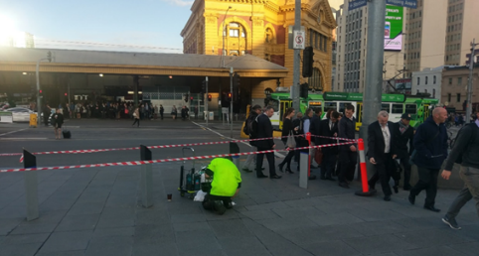
Observation:
High pedestrian volumes
Flinders Street Station, Australia’s busiest train station
Observation:
Use of tape as a containment option
Observation:
Substandard path width
Worksite
Federation Square, Melbourne, 8AM
Peak period
Notes:
Start with a picture of a worksite, set up
@ Fed Square
Adjacent to Australia’s busiest train station
Worksite set up in the AM Peak
Observations:
High ped volumes
Fragile containment of the site through tape
Narrow footpath width
→ Apparent, that pedestrian activity has not been adequately considered
Unfortunately, these kind of behaviours are commonly observed in dense urban surroundings
As part of the MTP, a need was identified to:

Slide 17
Study Scope and Approach
To support and progress changes in the treatment and consideration of vulnerable road users (pedestrians and cyclists) around worksite, to a level that is at least on par with the consideration of vehicle drivers.
Notes:
Support and progress changes in the treatment and consideration of VRYS around worksites, to a level that is at least on par with the condensation of vehicle drivers.

Slide 18
Study Scope and Approach
Stage 1 – Literature and background review
Stage 2 – Guidance
Stage 3 – Check sheets
Stage 4 – Application
Notes:
We set out to study and improve conditions for VRUs, dividing our approach into the following 4 steps:
..
Currently somewhere between Step 3 and 4.
As part of this background review, we did a number of onsite visits and developed a whole library of bad practice example pictures. Here are some of the common reoccurring bad practices.

Slide 19
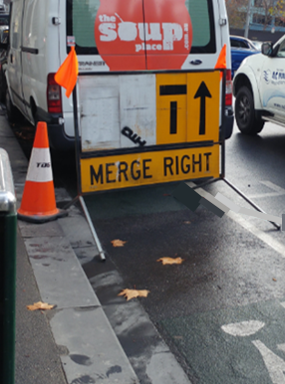
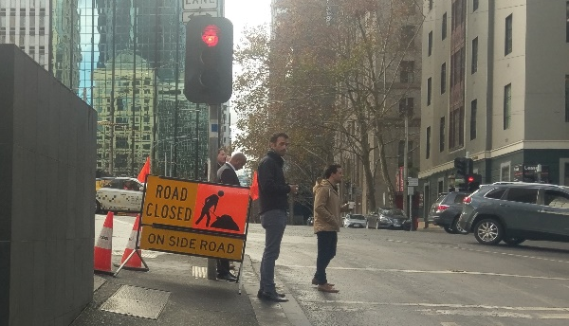
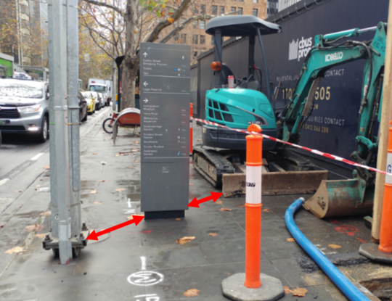
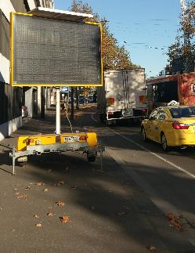
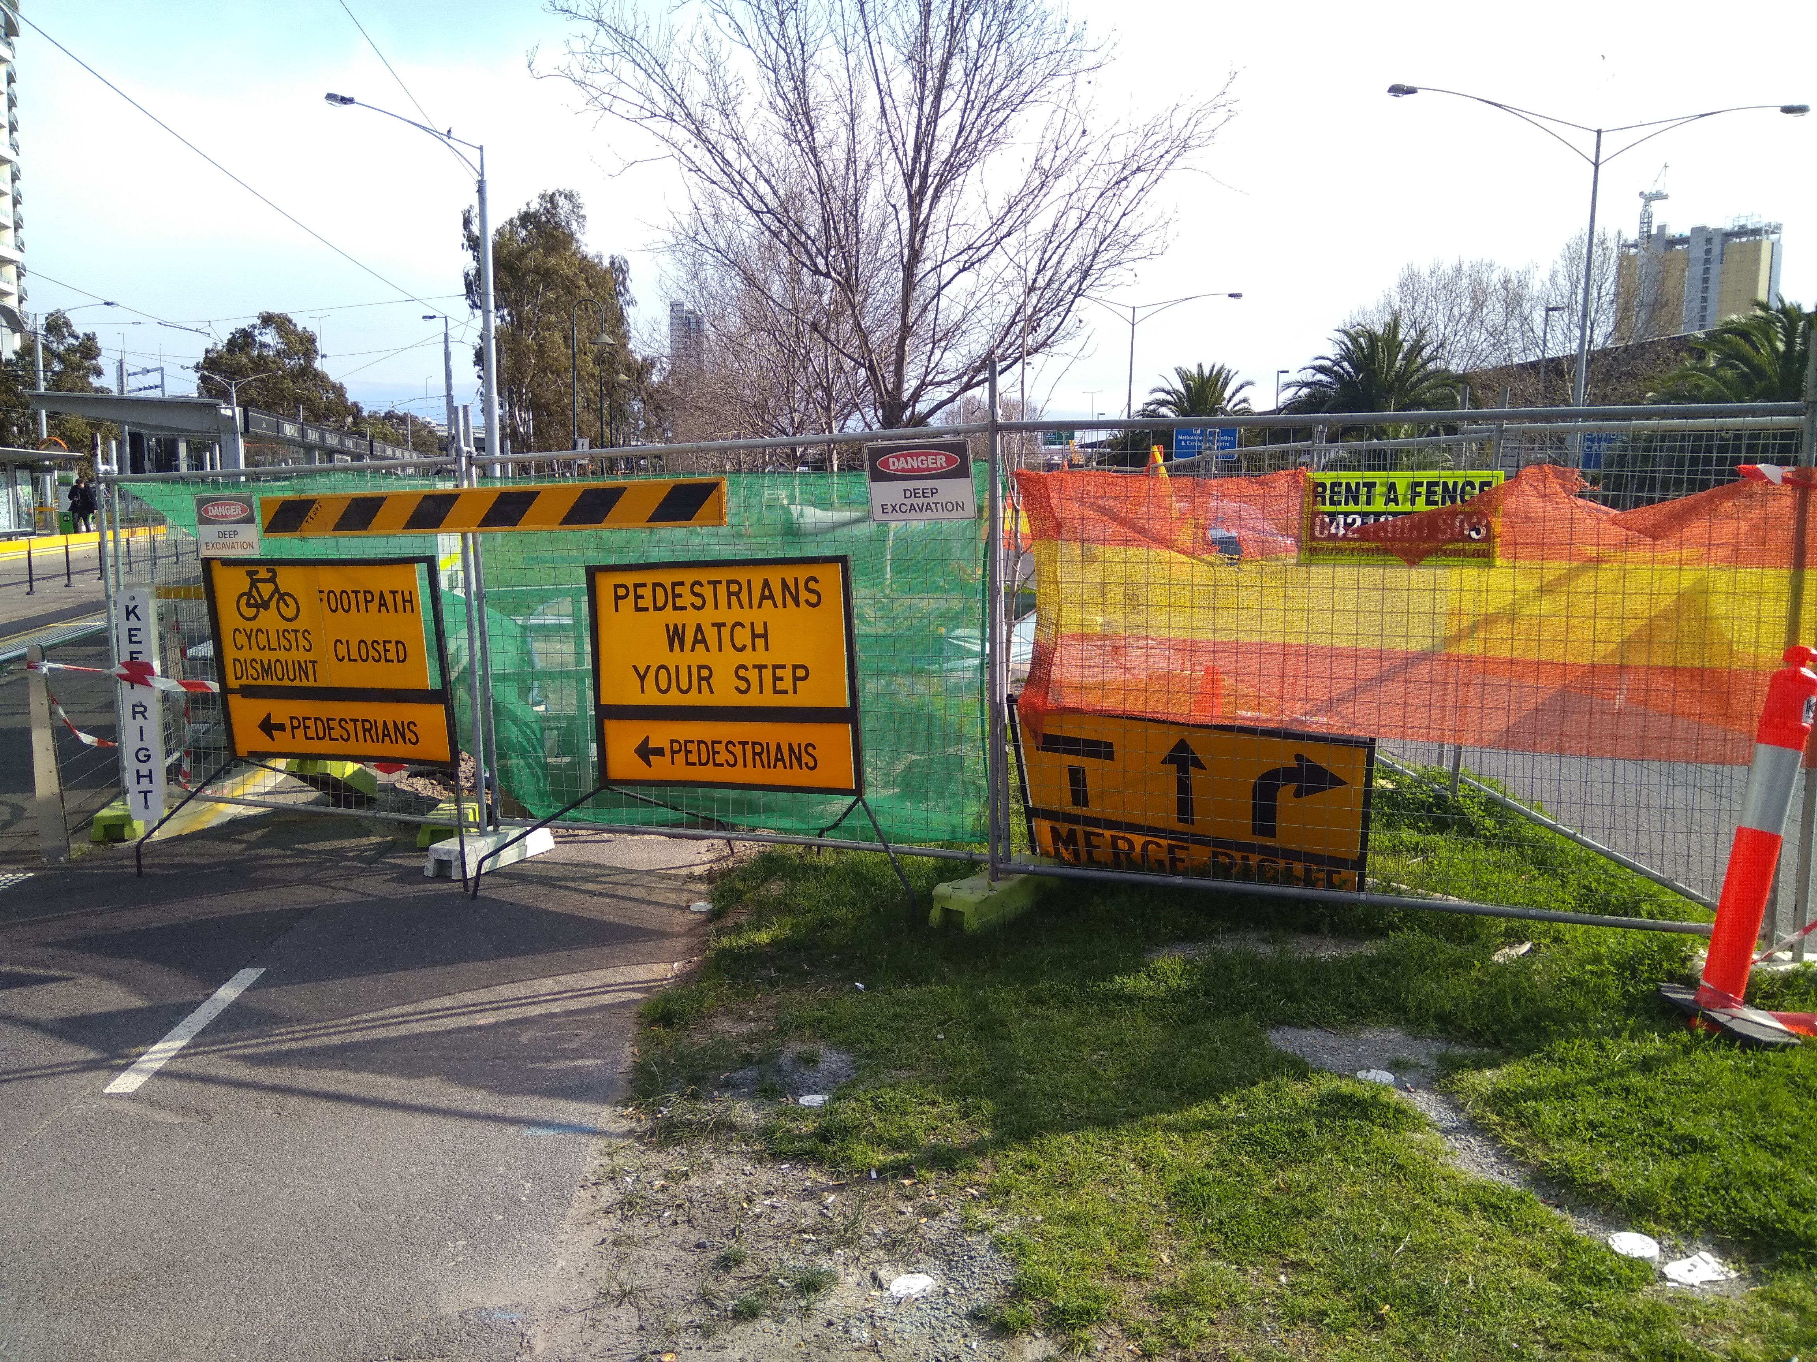
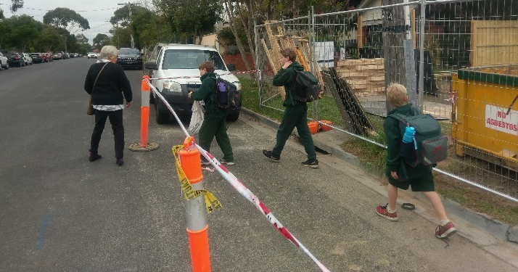
Key Issues - Examples
Closure of VRU paths
Pedestrian footpaths – Insufficient widths and obstructions
Obstructive sign placement
Use of substandard containment options

Slide 20
Background Review: Key Findings
Different interpretation and non- compliance of/with existing standards / guidance
Insufficient guidance in key areas affecting VRUs
Current guidance focused on vehicle management and minimising impact of works on drivers as well as the safety of construction workers
Over reliance on compliance with standards as opposed to measures/controls that adequately consider and address VRU safety
Lack of audit / enforcement of TMPs from approval agencies
Gap between strategy statements and treatment of VRU in temporary settings by approval agencies
Notes:
From onsite visits and background research the following overarching findings were made:
…

Slide 21
The Guidelines – Contents
  Path location and alignment
  Path widths
  Safety Barriers and Fencing
  Path surface
  Signage
  Path lighting
Notes:
Produced our own Guidelines, building on the background research.
Core of the Guidelines is divided into 6 main topics:
Path location and alignment
Suitable diversion routes + wayfinding strategies + personal safety
Path widths
Suitable widths for expected VRU volumes + DDA requirements
Safety barriers & fencing
Suitable containment options enhancing safety and wayfinding
Path surfaces
How slips, trips & falls can be mitigated
Signage
Improved sign options + associated placement
Lighting
Ensure sites well lit at all times for personal security + hazards identification

Slide 22
The Guidelines – Topic Approach
Each of the topics is addressed by providing information on:
Regulatory requirements
Objective and function
Things to avoid
Best practice
Notes:
Regulatory requirements and relevant industry guidelines
Identifies O&F that should be fulfilled under consideration of the 6 topics
…

Slide 23
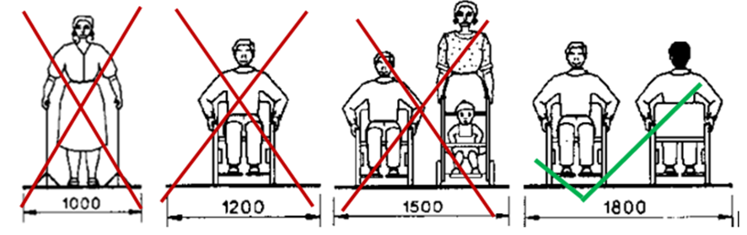
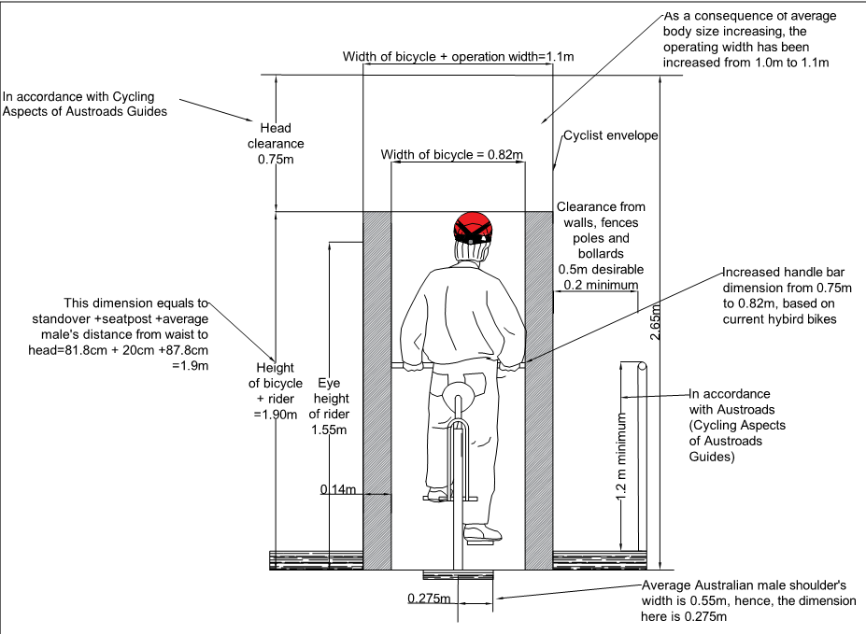
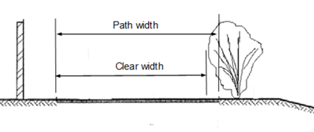
Guidance Document – Sample Contents (1)
Footpath width
Notes:
Path widths
Guidelines encourages practitioners to think about the following when selecting path widths:
User volumes
Upholding suitable LoS along the paths
Considering required operating spaces, including for those with mobility aids
Mitigation of obstacles
Acknowledgement that users/ peds don’t travel shoulder-shoulder/hoarding

Slide 24
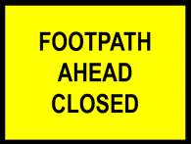

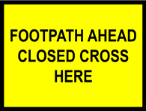
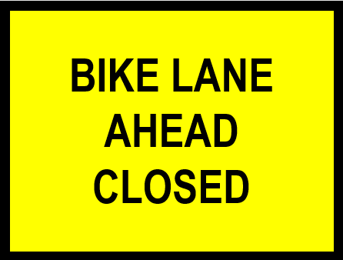

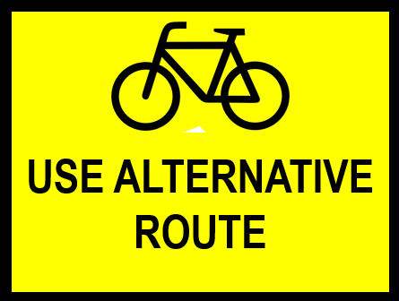

Guidance Document – Sample Contents (2)
Improved signs
Advanced warning and improved signs
Notes:
Sample content – Signs
Lack of signs in the Australian standards for peds + cyclists
Produce a suite of additional sign options, to enable a more tailored sign selection for individual sites
We are currently working closely with VicRoads to develop these further.

Slide 25
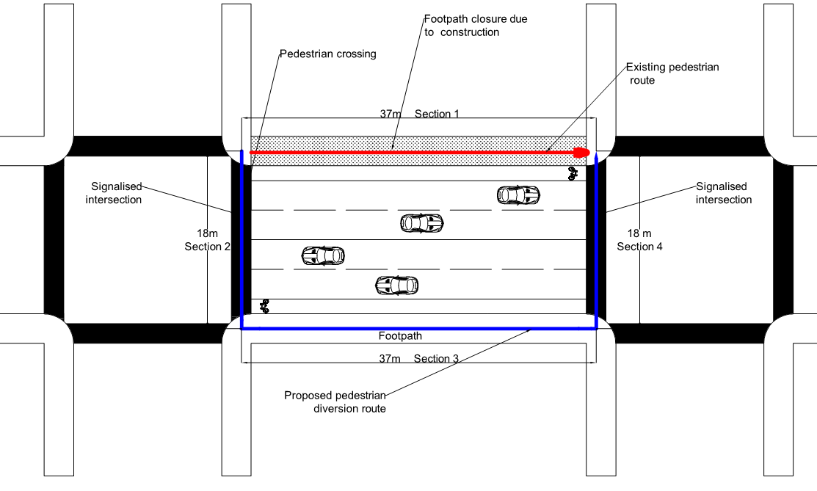
Guidance Document – Sample Contents (3)
Path location and alignment
Are diversion routes practical?
Notes:
Section encourages practitioners to think about the routes VRUs are sent on around sites. Are they practical in terms of journey time?
The example shows a common occurrence of a footpath being closed, with the diversion of pedestrians to the south.
Under such conditions it is worth undertaking a check to see how much travel times increase on the diversion routes. If it’s substantial there is a danger that pedestrians will select their own, shorter route that may be less safe.

Slide 26
Checklists
The Guidelines are extensive and provide information on background and approach
They are intended as a document that can be draw upon in the development of TMPs
For onsite use, condensed checklists of the 6 topics have been produced
Electronic as well as hardcopy versions
These are currently being trialled on MTP sited, with the intention of use across other constructions sites.
Notes:
Guidelines extensive, are to aid in the development of TMPs
Complement the Guidelines, a set of condensed checklists have been developed, for onsite use
Currently in hardcopy, electronic versions are being developed and also undergoing trials on MTP sites

Slide 27
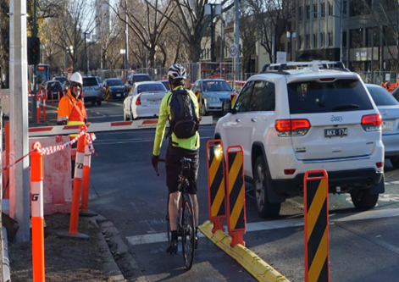
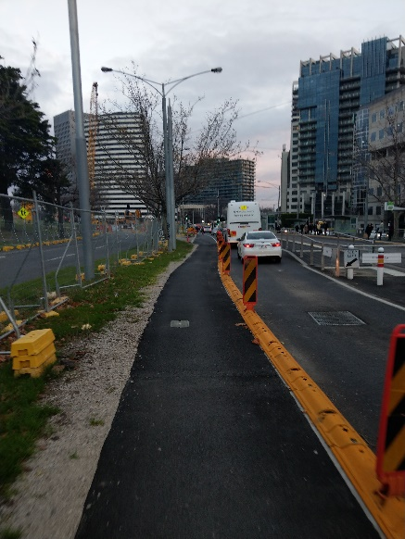
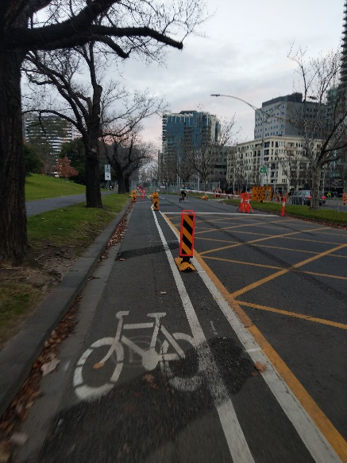
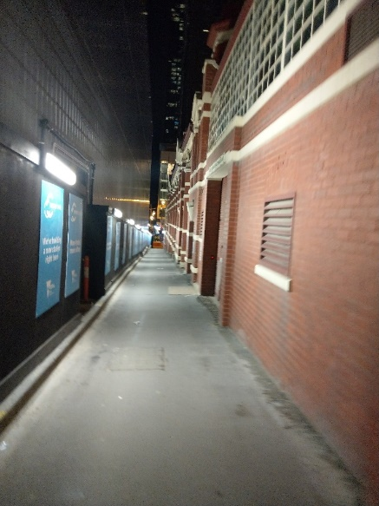
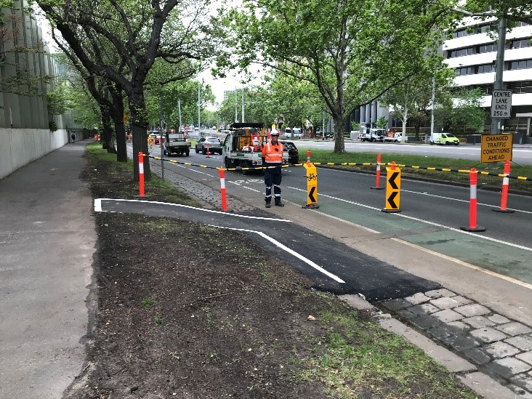
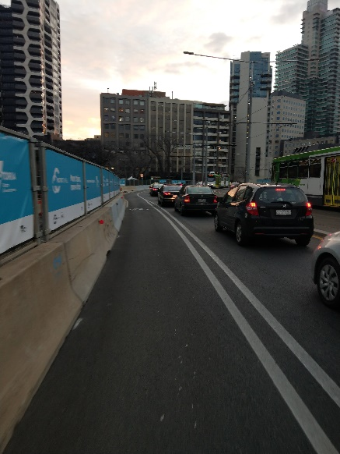
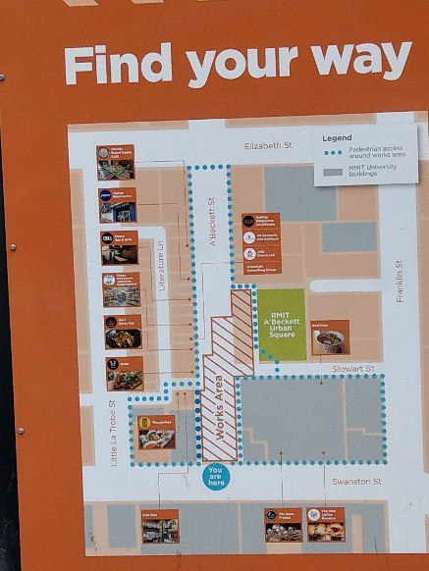
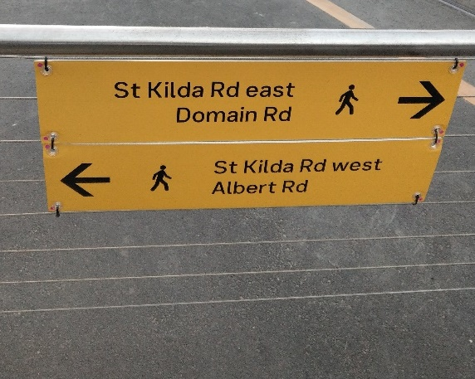
Positive measures in place on MTP
Notes:
Application examples on MTP
Improved signage, delineation for cyclists, well-lit diversion routes, smooth hoarding

Slide 28
Next Steps: Guidelines & HIRA Tool
Complete the digitalisation of both tools
  Create an internet-based interface for self-facilitated workshops
Undertake further trials around worksites
Work with RPV, VicRoads and other project stakeholders on ownership and enforcement of the Guidelines and Tools
  Determine availability and distribution of the work to the wider public
Develop an understanding of the possibilities of state and nation wide rollout

