Slide 1
Guidance for Safe Routes to School grant applications
Community Road Safety Grants Program
September 2020

Slide 2

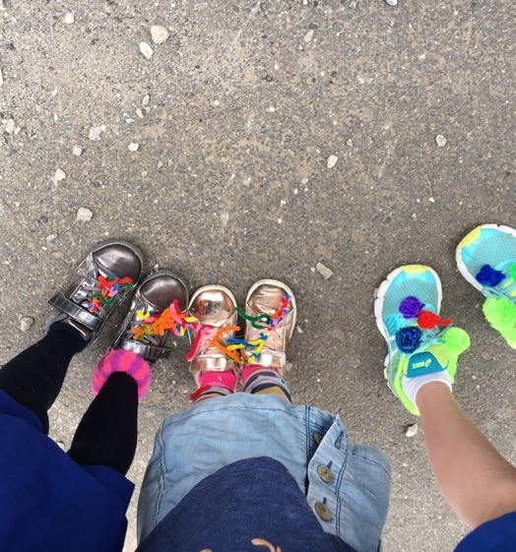
What we will cover
  Safe Routes to School projects
  What is eligible for funding
  Safe Routes to School approach
  Successful project elements
  Case study – East Gippsland Shire Council
  School engagement
  Monitoring and evaluation
  Useful resources
  Tips for preparing an application

Slide 3
Safe Routes to School program and approach

Slide 4

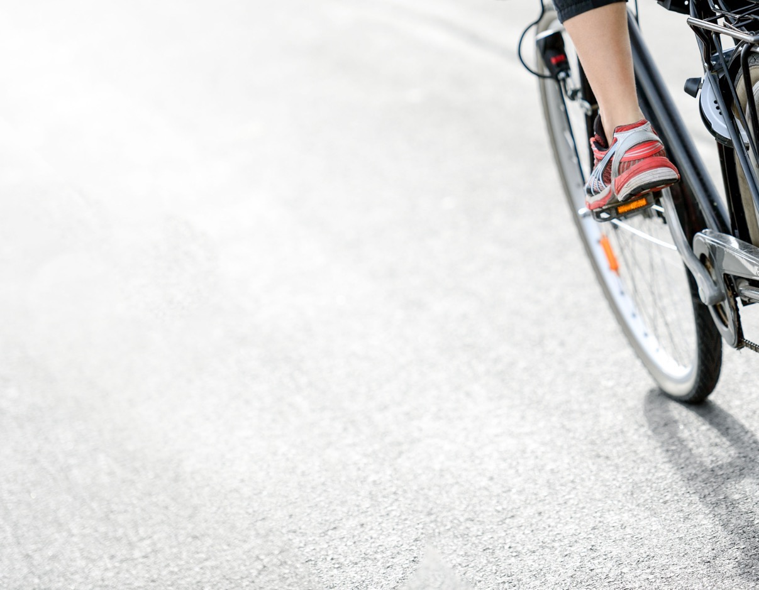
Safe Routes to School projects
Department of Transport supports local community road safety projects with funding from its Community Road Safety Grants Program, which includes Safe Routes to School.
Safe Routes to School supports a range of education and behavioural change projects to:
  Improve road safety around pick up and drop off times
  Create safe routes to school
  Encourage active travel to school

Slide 5
What is eligible for funding
  Council officer wages cannot be funded. Funding may be used to pay contractors to deliver projects
  Standard traffic management infrastructure improvements are NOT funded (eg parking management signs, road crossings etc). These may be identified as complementary actions to be funded and delivered by council as part of the project
  Bike/scooter racks and shelters are not funded
  Small-scale infrastructure and signage that directly support behavioural actions may be funded eg active travel wayfinding (decals and signs), kiss and drop signs and marking
  Maximum $6,000 per school (exclusive of GST and administration funding). Capped at $30,000 per applicant (GST exclusive)
Funding is available to support education and behavioural change actions that improve road safety and encourage active travel.
This includes:
  Design and analysis eg student catchment maps and walking audits to identify priority routes to school
  Delivery eg road safety incursions, active travel events and campaigns and supporting materials
  Evaluation eg online surveys, intercept surveys, student and parent workshops

Slide 6
Safe Routes to School approach
  Department of Transport encourages local councils and schools to apply common approach projects funded under the program.
  Successful SRTS projects:
  Use a mix of improvements – engineering, education, engagement and enforcement – to improve road safety and increase active travel to school
  Establish local council and school partnership that is ongoing
  Work with students and the school community to design and implement locally-relevant actions
  Monitor and evaluate changes in road safety and active travel to school

Slide 7
Safe Routes to School approach
  Department of Transport has two resource documents to help local councils design, implement and evaluate projects to support road safety and active travel to school.
  Safe Routes to School Guide
  SRTS Processes and Templates for Councils
  The guides are on the pedestrian safety page of the VicRoads website
  https://www.vicroads.vic.gov.au/safety-and-road-rules/pedestrian-safety
Assess local school context, road safety and active travel issues & needs
Develop SRTS action plan with the school community
Implement, monitor, evaluate SRTS plan, alongside council road safety infrastructure improvements
Guidance for Safe Routes to School grant applications

Slide 8
Safe Routes to School approach
Combine education and behaviour change actions with road safety infrastructure
ENGINEERING
EDUCATION
ENCOURAGEMENT
ENFORCEMENT
Review existing facilities. Identify infrastructure & parking management improvements*.
Map & sign priority safe travel routes
Identify and deliver focus areas for road safety education activities using resources from VicRoads & other agencies
Identify and deliver school-led behaviour change activities including events, campaigns and participation in active travel programs
Identify and deliver enforcement strategies, as needed, at the school-level, local laws officers or by police
*Traffic and road safety infrastructure may be identified as actions to be funded and delivered by council as part of the Safe to Routes School project
Guidance for Safe Routes to School grant applications

Slide 9
Successful project elements
Guidance for Safe Routes to School grant applications

Slide 10
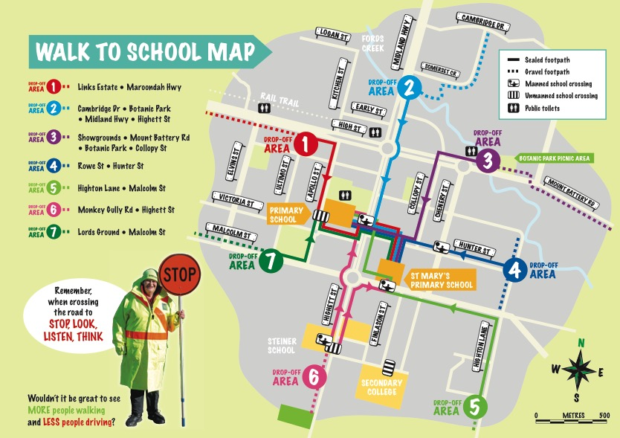
Successful project elements
Combine education and behaviour change actions with road safety infrastructure
Routes to school
  Identifying popular routes
  Safety audits
  Decals, footpath stickers
  Maps & signs
  Park and walk locations
Guidance for Safe Routes to School grant applications

Slide 11
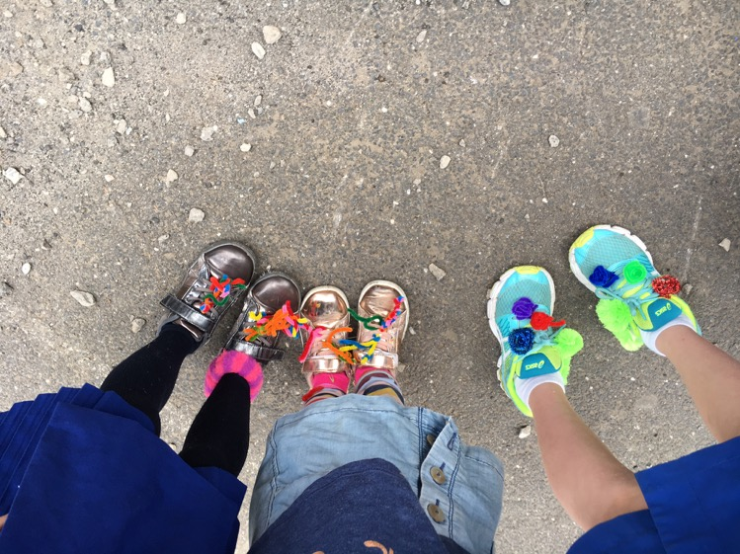
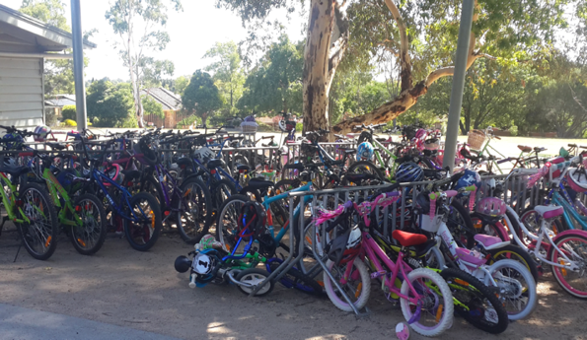
Successful project elements
Combine education and behaviour change actions with road safety infrastructure
Education and events
  Road safety programs/incursions
  Special guests
  Active travel breakfasts
  Smoothie bikes
  “Bling your bike” “fancy feet”
Guidance for Safe Routes to School grant applications

Slide 12
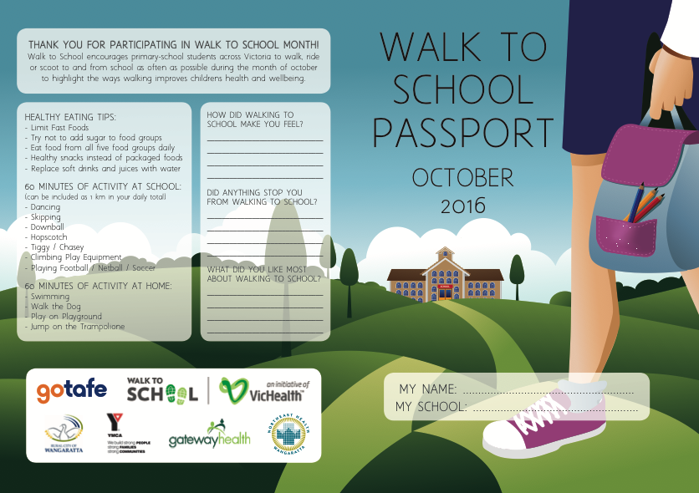
Successful project elements
Combine education and behaviour change actions with road safety infrastructure
Campaigns, competitions, incentives
  Walk and Wheel Wednesdays
  Walk to School month each October
  Track active travel (passports, wristbands, stickers, classroom tallies)
  Golden boot class awards
Guidance for Safe Routes to School grant applications

Slide 13
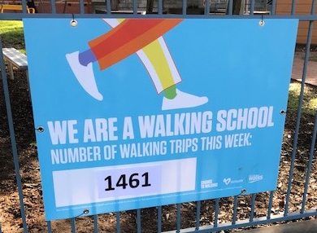
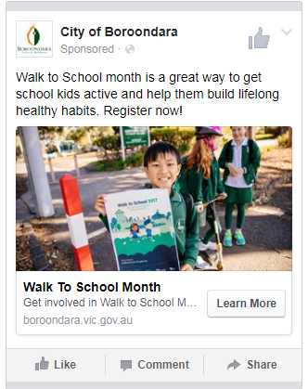
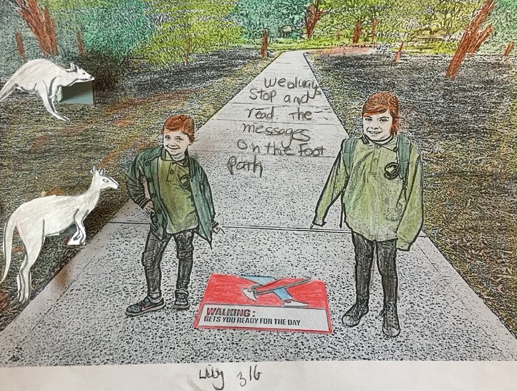
Successful project elements
Combine education and behaviour change actions with road safety infrastructure
Promote, share success and personal stories
  Social media posts and videos
  School newsletter articles
  School app prompts and reminders
  Art and story competitions
  Public pledges
Guidance for Safe Routes to School grant applications

Slide 14
Case study
East Gippsland Shire Council
Guidance for Safe Routes to School grant applications

Slide 15









Program Partners
Victorian Police
East Gippsland Shire Council
Vic Health’s Walk to school program
Vic Roads
East Gippsland Local Road Safety Committee
Nicholson Primary School
Swan Reach Primary School
Nungurner Primary School
St Brendan’s Catholic Primary School
East Gippsland’s
Safe Routes to School Program

Slide 16
Local Community Road Safety Committee (LCRSC) made up of local representatives from Victoria Police, VicRoads (now Department of Transport), EGSC, Councillors and Community
LCRSC
Safe Routes to School
Walk to School
Community Road Safety program integrated with Walk to School, a VicHealth initiative
Facilitator
$30 000 funding (combined CRS and VicHealth) used for contracted STS facilitator’s salary to deliver projects across four schools
Implement SRTS program in four school communities: Nicholson, Swan Reach, Nungurner, and St Brendan’s Catholic Primary Schools
Community

Slide 17
Nicholson Primary “What we Did”
July – September
  Communication/ engagement plan
  Collect baseline data, survey 1
  Project Reference Group set up
  Program Launch
  Access audits of school areas
  Engage with community groups
  Develop travel Safely to school policy
  Walk to School promotion
  Poster competition
October – December
  Promotion and use of road safety resources
  Walk to School activities
  Pedestrian data
  Prepare & distribute survey 1 Report
  Promote road safety messages to school community
  Develop Traffic Management Guides and Signage
  Monitor driver behaviours
January - March
  Promote Travel Safely to school policies
  Launch Traffic Management Guides and teaching resources within school communities and the wider community
  Encourage compliance with Victoria Police presence
May – June
  Survey 2 and traffic audits to measure change in road safety behaviour
  Analyse results, evaluate project
  LCRSC report on STS program.
  Distribute data, key road safety messaging and promotion to school community
  Infrastructure review and future recommendation
  TAC Local Government infrastructure grants application
  VicRoads Final report

Slide 18
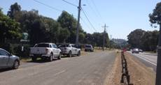
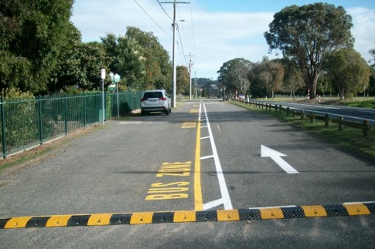
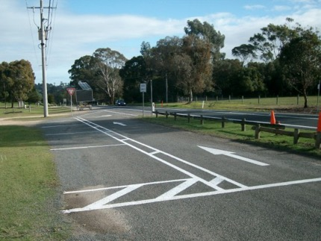
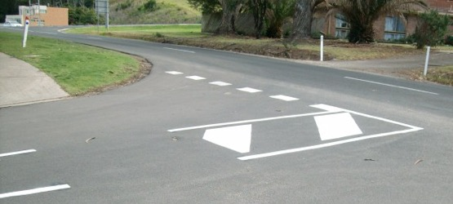
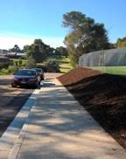
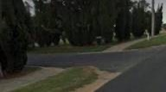
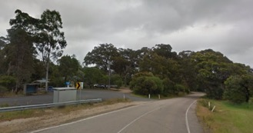
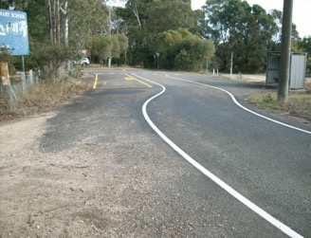
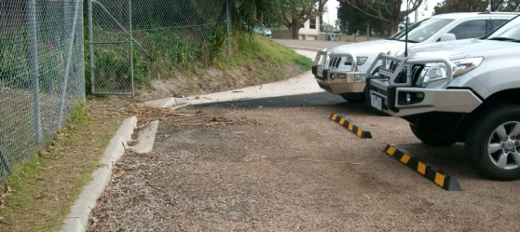
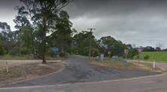
East Gippsland’s Program improved infrastructure
Transformed this
Into this

Slide 19
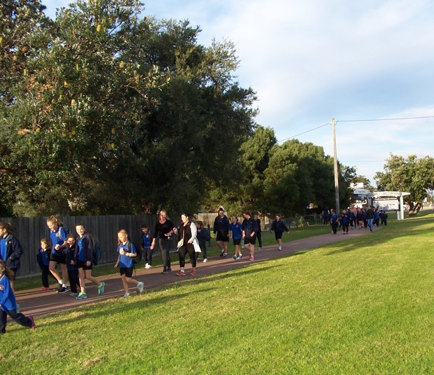
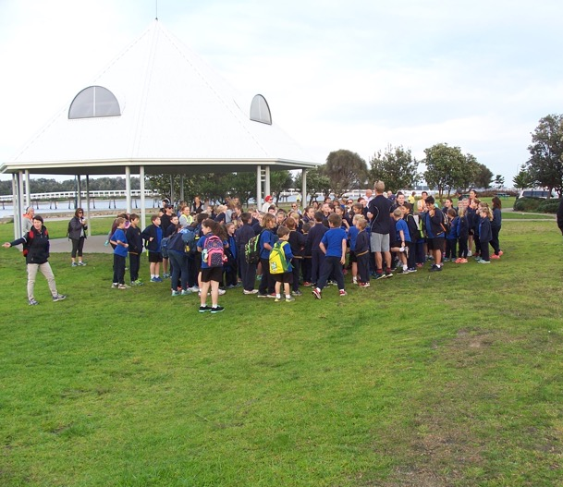
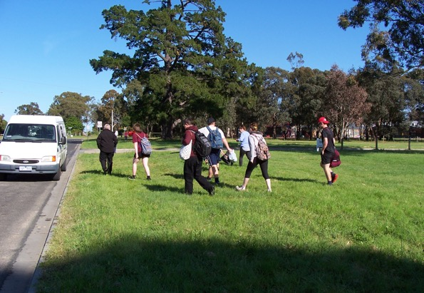
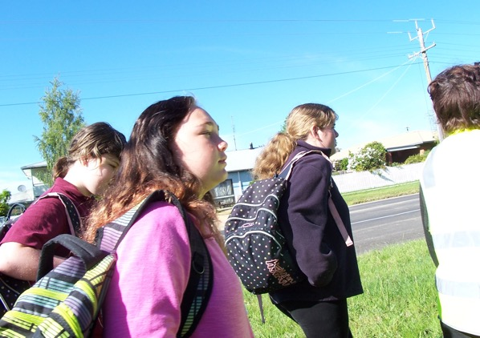
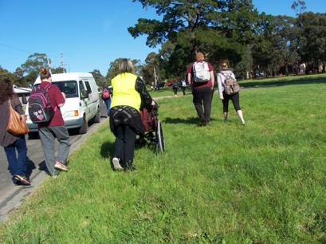
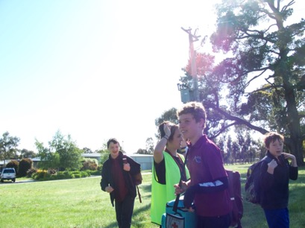
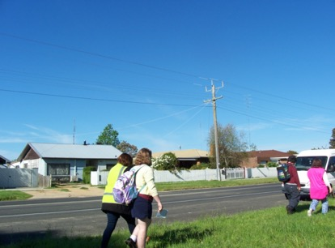
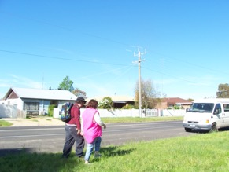
Promoted active travel

Slide 20
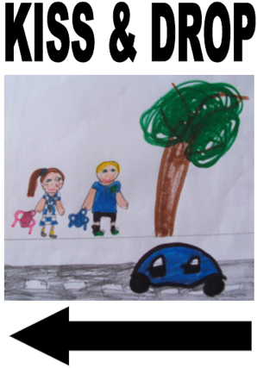
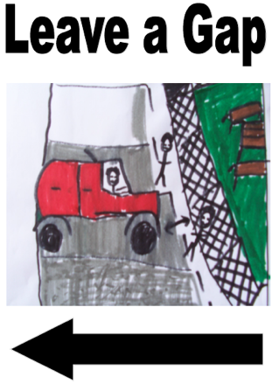
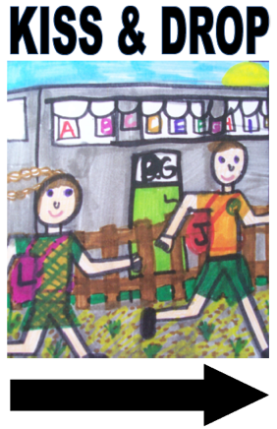
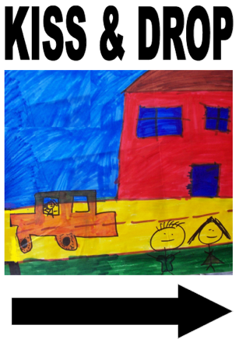
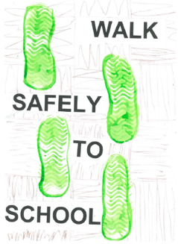
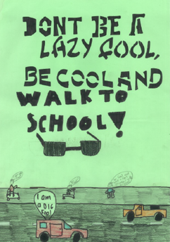
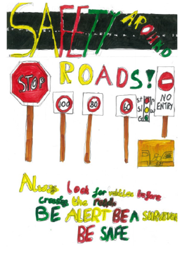
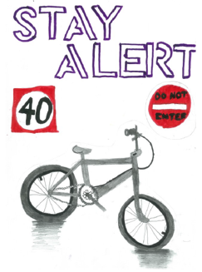
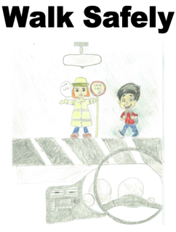
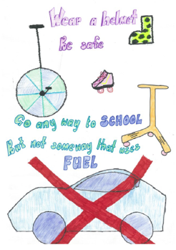
Produced signage from students artwork

Slide 21
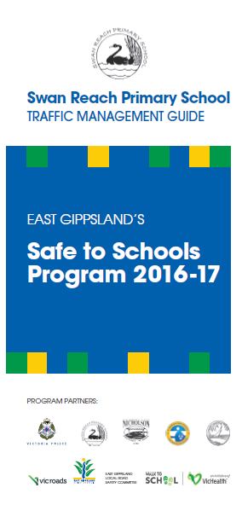


Produced Traffic Management Guides for each school

Slide 22
Program sustainability: all four schools…
Adopted Travel Safely to School policies
Implemented traffic management guide
Embedded school road safety education into their curriculum
Continue approved road safety education and active travel programs, e.g. Ride to School and Walk to School
Used data collected during the program to inform further infrastructure funding

Slide 23
Common questions
School engagement
Evaluation
Guidance for Safe Routes to School grant applications

Slide 24
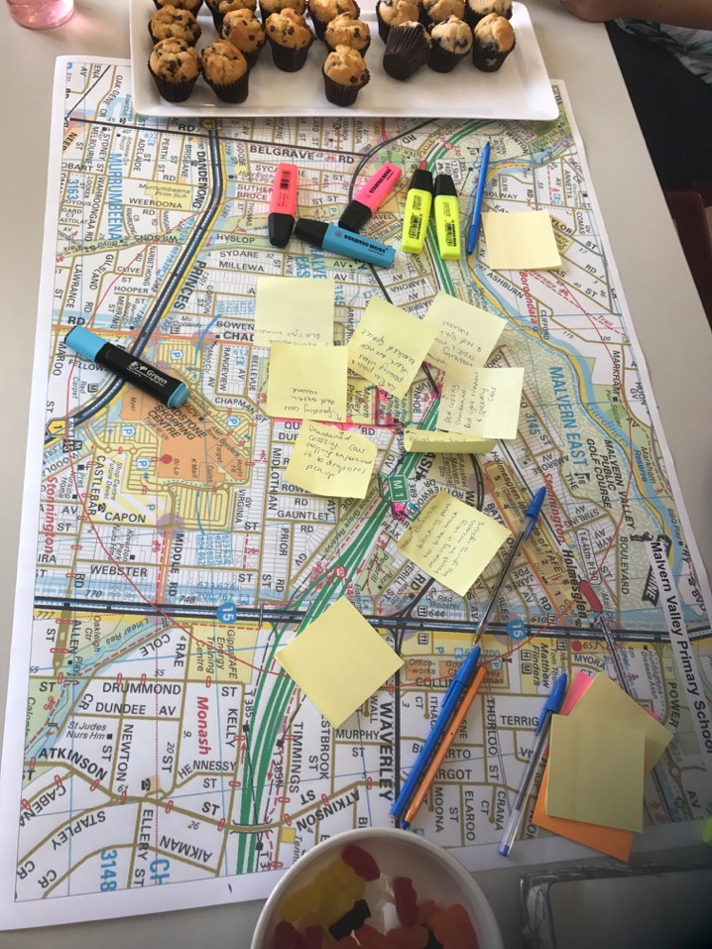
School engagement
It is preferable to have school partners on board when applying for Safe Routes to School funding
  Early and sustained engagement is essential to:
    Gain commitment
    Identify issues and opportunities for change
    Design actions that are relevant to the school
    Recruit volunteers (students, parents, teachers) to help deliver and evaluate actions
  Engagement ideas:
    Pop-up stalls, intercept surveys at existing school events (assemblies, fetes)
    Online surveys
    Student leader working groups
    Meetings with school council and leadership
  Student-led actions often help build ownership
Guidance for Safe Routes to School grant applications

Slide 25
Monitoring and evaluation
  Include monitoring and evaluation in your project design
  Safe Routes to School-funded projects need to assess:
    Participation and project reach
    What has changed
    Expected outcomes, as well as processes and impacts
  Match your evaluation to your budget
  Students can help with monitoring and evaluation activities
Guidance for Safe Routes to School grant applications

Slide 26
Process, outcome and impact evaluation
What you are measuring
Example evaluation measures
Process
Reach of project – awareness and participation
Effective and efficient program delivery
Proportion of students & families participating in project events
Social media views and likes
Actions delivered within budget
Outcome
Changes in capabilities and behaviours:
  Changes in active travel rates
  Changes in road safety capabilities and behaviours of pedestrians, cyclists, passengers, drivers
% change in active travel to school
Changes in illegal parking outside school
Changes in unsafe crossing behaviours
Impact
Influence of the project on policy, structural or other changes beyond the project
Includes sustainability of the project within school and council
Changes in school policy & actions to support active travel, eg student committee
Alignment of future SRTS projects and council capital works program
Guidance for Safe Routes to School grant applications

Slide 27
Preparing an application
Guidance for Safe Routes to School grant applications

Slide 28
Project resources
  Department of Transport Safe Routes to School Guide Section 7 lists Victorian road safety education and active travel programs
  These programs have resources to help you design and deliver different parts of your SRTS project, such as in-class road safety teaching guides, audit tools, behavioural campaign ideas, active travel route identification and support etc
  The guide is available on the pedestrian safety page of the VicRoads website
  https://www.vicroads.vic.gov.au/safety-and-road-rules/pedestrian-safety
Guidance for Safe Routes to School grant applications

Slide 29
Tips for preparing a Safe Routes to School application
Speak with your local Community Road Safety coordinator, even if you have previously applied for funding. Coordinators are listed on the Community Road Safety Grants program webpage.
  Read the Safe Routes to School Guide
  Gain commitment from your partner school/s (or your local council, if you are a school)
  Be specific about what actions you will deliver
  Check what you are applying for is eligible for funding
  Attach supporting evidence
  Include past project outcomes (focus on changes in road safety and active travel behaviours)
  Show project need and supporting actions to date
  Describe your approach to school engagement and gaining their support
Guidance for Safe Routes to School grant applications

